Slide 1
ACCTG 325 Video T8E
1231 and Recapture

Slide 2
1231 and Recapture
This is a tough area of the tax code to get your hands around so expect a long video
Lots of “iterations” so be sure and understand the context of the problem so you can connect the solution to the appropriate facts
The Code sections that cover the character of a gain or loss do not affect the amount of the recognized gain or loss ONLY its character

Slide 3
1231 and Recapture
Learn it placeholder

Slide 4
1231 and Recapture
Recall this…..not not a capital asset
Capital Assets - Anything that is not NOT a capital asset (yup, double-negative)
(2) Trade or business property
Property used in a trade or business is NOT a capital asset
Which, of course, that it is an ordinary asset
Which means that sales of trade or business property produce ordinary gains and losses….or do they?

Slide 5
1231 and Recapture
Section 1231
Net all gains and losses from sales of 1231 property
If a gain: capital gain
If a loss: ordinary loss

Slide 6
1231 and Recapture
Corporate | Cap Loss | Ord Loss | Cap Gain | Ord Gain
Operating income | 10,000 | 10,000 | 10,000 | 10,000
Capital Gain/(Loss) | (4,000) |  | 4,000
Ordinary Gain/(Loss) |  | (4,000) |  | 4,000
Taxable income | 10,000 | 6,000 | 14,000 | 14,000
Tax | (2,100) | (1,260) | 2,940 | 2,940
Individual (assume 28%)
Operating income | 10,000 | 10,000 | 10,000 | 10,000
Capital Gain/(Loss) | (4,000) |  | 4,000
Ordinary Gain/(Loss) |  | (4,000) |  | 4,000
Taxable income | 7,000 | 6,000 | 14,000 | 14,000
Tax | (1,960) | (1,680) | 3,400 | 3,920

Slide 7
1231 and Recapture
Thus 1231 is the best of both worlds!
1231 property
Property used in a trade or business and held for more than 1 year
Thus trade or business property held for < 1 year is ordinary

Slide 8
1231 and Recapture
Bill’s business has a number of 1231 assets it wants to sell
If Bill sells all the assets this year:
Net gain=$700, capital gain treatment under 1231
What if sells all losses this year?
Net loss $5,000 ordinary loss
Then sells all the gains first day of following year?
Net gain of $5,700 is capital gain
 | Basis | FMV | Gain/(Loss)
Asset A | $3,000 | $1,000 | ($2,000)
Asset B | $5,000 | $2,000 | ($3,000)
Asset C | $2,500 | $5,500 | $3,000
Asset D | $0 | $2,700 | $2,700
Total |  |  | $700

Slide 9
1231 and Recapture
Bill’s business has a number of 1231 assets it wants to sell
Sell all: $700 cap gain at 15% = taxes of $105
Sell loss this year $5,000 ordinary loss x 28% = $1,400 tax savings
Then sells all the gains first day of following year Net gain of $5,700 is capital gain x 15% = $855
By splitting the years, Bill saves $545 in taxes instead of paying $105
 | Basis | FMV | Gain/(Loss)
Asset A | $3,000 | $1,000 | ($2,000)
Asset B | $5,000 | $2,000 | ($3,000)
Asset C | $2,500 | $5,500 | $3,000
Asset D | $0 | $2,700 | $2,700
Total |  |  | $700

Slide 10
1231 and Recapture
1231 Lookback
Must look back 5 years and “recapture” ordinary losses
Doesn’t mean loss is “unwound” but rather the character of this gain will be ordinary not capital
Year 1: Bill sells Assets A and B and generates $5,000 ordinary loss under 1231
Year 2: Bill sells Assets C and D and generates $5,700 capital gain under 1231 except…
Lookback rule says lookback 5 years
Any 1231 ordinary losses unrecaptured previously?
Recharacterize the gain as ordinary
Bill has a $5,000 ordinary gain and a $700 capital gain BUT total gain amount is same
 | Basis | FMV | Gain/(Loss)
Asset A | $3,000 | $1,000 | ($2,000)
Asset B | $5,000 | $2,000 | ($3,000)
Asset C | $2,500 | $5,500 | $3,000
Asset D | $0 | $2,700 | $2,700

Slide 11
1231 and Recapture
Learn it

Slide 12
1231 and Recapture
Section 1231 summary example
Luigi operates a parking lot business and has the following business property sales
Determine Luigi’s recognized gain/loss and the character.
 | Purchased | Sold | Basis | Amount Realized
Land #1 | Jan 01, 2011 | Jul 4, 2017 | 50,000 | 40,000
Land #2 | Sep 22, 2014 | Oct 17, 2018 | 40,000 | 45,000
Land #3 | Dec 12, 2017 | Oct 17, 2018 | 80,000 | 90,000

Slide 13
1231 and Recapture
 | Purchased | Sold | Basis | Amount Realized | Gain/(Loss)
Land #1 | Jan 01, 2011 | Jul 4, 2017 | 50,000 | 40,000 | (10,000)
Land #2 | Sep 22, 2014 | Oct 17, 2018 | 40,000 | 45,000 | 5,000
Land #3 | Dec 12, 2017 | Oct 17, 2018 | 80,000 | 90,000 | 10,000
2017 sale results in a loss of $10,000
Character: It’s 1231 property so ordinary loss
2018 sales result in one gain of $5,000 and one gain of $10,000
Character: Land #3 is NOT 1231 property (held less than 1 year) so ordinary gain
Land #2 is 1231 property but requires 1231 lookback to recharacterize $5,000 gain as ordinary gain
Result in 2018 is $15,000 ordinary gain

Slide 14
1231 and Recapture
Lola owns a business asset that she placed in service 6 years ago. The original basis was $50,000. It is now almost fully depreciated (basis=$5,000) and she is going to sell it for $10,000. This is her only asset sale this year (no 1231 lookback)
History: Lola has taken $45,000 of ordinary deductions for depreciation on the asset for the past 6 years
Assume Lola has a 35% marginal tax rate, she will have tax savings of $15,750 ($45,000 x 35%)
This is 1231 property and so the gain will be characterized as a capital gain
Her cap gain rate is 15% so the gain will be taxed at 15% of $750
Is it possible that the reason that she had any gain at all is because she “over-depreciated” the asset?
Cost of $50,000 minus Cost recovery of $45,000 leaving Adjusted basis of $5,000
FMV=$10,000
Really didn’t Lola just over-recover her costs?
Should there be a tax break for that?

Slide 15
1231 and Recapture
§1245 Property
Personal property and amortizable intangible assets are §1245 assets
The lesser of
gain recognized or
accumulated depreciation
is recaptured (characterized) as ordinary income under §1245
Any remaining gain is §1231 gain
There is no depreciation recapture on assets sold at a loss

Slide 16
1231 and Recapture
Another way of thinking about this is to say treat the gain as ordinary for the lesser of the gain amount of depreciation taken
A |  | Amount realized | $10,000 | $40,000 | $55,000 | $3,000
B |  | Basis | $5,000 | $5,000 | $5,000 | $5,000
C | A-B | Realized/Recognized gain/(loss) | $5,000 | $35,000 | $50,000 | ($2,000)
D |  | Depreciation taken | $45,000 | $45,000 | $45,000 | $45,000
E | Lesser of D or C (for gains only) | Recapture Ordinary Character | $5,000 | $35,000 | $45,000 | 0
F | C-E | 1231 Character | 0 | 0 | $5,000 | ($2,000)

Slide 17
1231 and Recapture
When taxpayers sell or dispose of §1245 property, they encounter one of the following three scenarios of gain or loss
recognize a gain created solely through depreciation deductions
recognize a gain created through both depreciation deductions and actual asset appreciation
recognize a loss

Slide 18
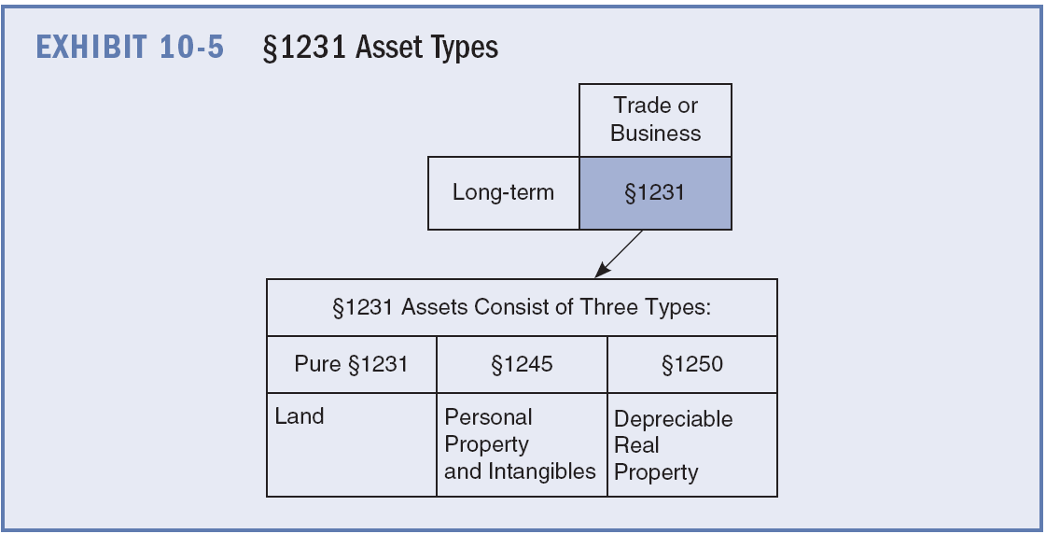
1231 and Recapture
World of 1231

Slide 19
1231 and Recapture
§1245 covers personal property…what about real property?
Depreciable real property (an office building or a warehouse), sold at a gain is subject to recapture called “§1250 depreciation recapture”
A modified version of the recapture rules called §291 depreciation recapture applies to corporations but not to other types of taxpayers
§291, corporations selling depreciable real property recapture as ordinary income 20 percent of the lesser of the recognized gain or the accumulated depreciation
Before we move on – remember recapture affects the character not the amount of the gain!

Slide 20
1231 and Recapture
Learn it placeholder

Slide 21
1231 and Recapture
However, Congress loves real estate
Only required to recapture (re-characterize) capital gain as ordinary gain to the extent is relates to ACCELERATED depreciation
What do these tables have in common?
Only STRAIGHT LINE depreciation
Wohoo! No such thing as 1250 recapture since 1981!

Slide 22
1231 and Recapture
However, not out of the woods
If an individual sells real business property at a gain
The unrecaptured depreciation is treated as LTCG but is taxed at a 25% rate
If a corporation sells the real business property at a gain
20% of the unrecaptured depreciation is treated as ordinary and the rest stays a 1231 LTCG
Go ahead, look up “unrecaptured.” Its not really a word as far as I am concerned!

Slide 23
1231 and Recapture
Re-do on Lola except REAL property (Lola is an individual)
The only difference is the treatment of the recapture – everything else is the same as personal property
A |  | Amount realized | $10,000 | $40,000 | $55,000 | $3,000
B |  | Basis | $5,000 | $5,000 | $5,000 | $5,000
C | A-B | Realized/Recognized gain/(loss) | $5,000 | $35,000 | $50,000 | ($2,000)
D |  | Depreciation taken | $45,000 | $45,000 | $45,000 | $45,000
E | Lesser of D or C (for gains only) | Unrecaptured 1250 (25%) | $5,000 | $35,000 | $45,000 | 0
F | C-E | 1231 Character | 0 | 0 | $5,000 | ($2,000)

Slide 24
1231 and Recapture
Re-do on Lola except REAL property (Lola is a corporation)
A |  | Amount realized | $10,000 | $40,000 | $55,000 | $3,000
B |  | Basis | $5,000 | $5,000 | $5,000 | $5,000
C | A-B | Realized/Recognized gain/(loss) | $5,000 | $35,000 | $50,000 | ($2,000)
D |  | Depreciation taken | $45,000 | $45,000 | $45,000 | $45,000
E | Lesser of D or C (for gains only) | Recapture under 1245 | $5,000 | $35,000 | $45,000 | 0
F | 20% of E | 291 treated as ordinary | $1,000 | $7,000 | $9,000
F | C-F | 1231 Character | $4,000 | $28,000 | $41,000 | ($2,000)

Slide 25
1231 and Recapture
What was important to note about the total amount of gain or loss in all of the examples we just completed?
It was NOT changed by the recapture rules – only the character changed

Slide 26
1231 and Recapture
Learn it

Slide 27
1231 and Recapture
Whew – that was exhausting and this video is long enough already.
Great comprehensive example in textbook on pp. 229-230 and look at the flowchart on p. 231

Slide 28
1231 and Recapture
End of Video T8E

