Slide 1
ACCTG 325 Video T8D
Character

Slide 2
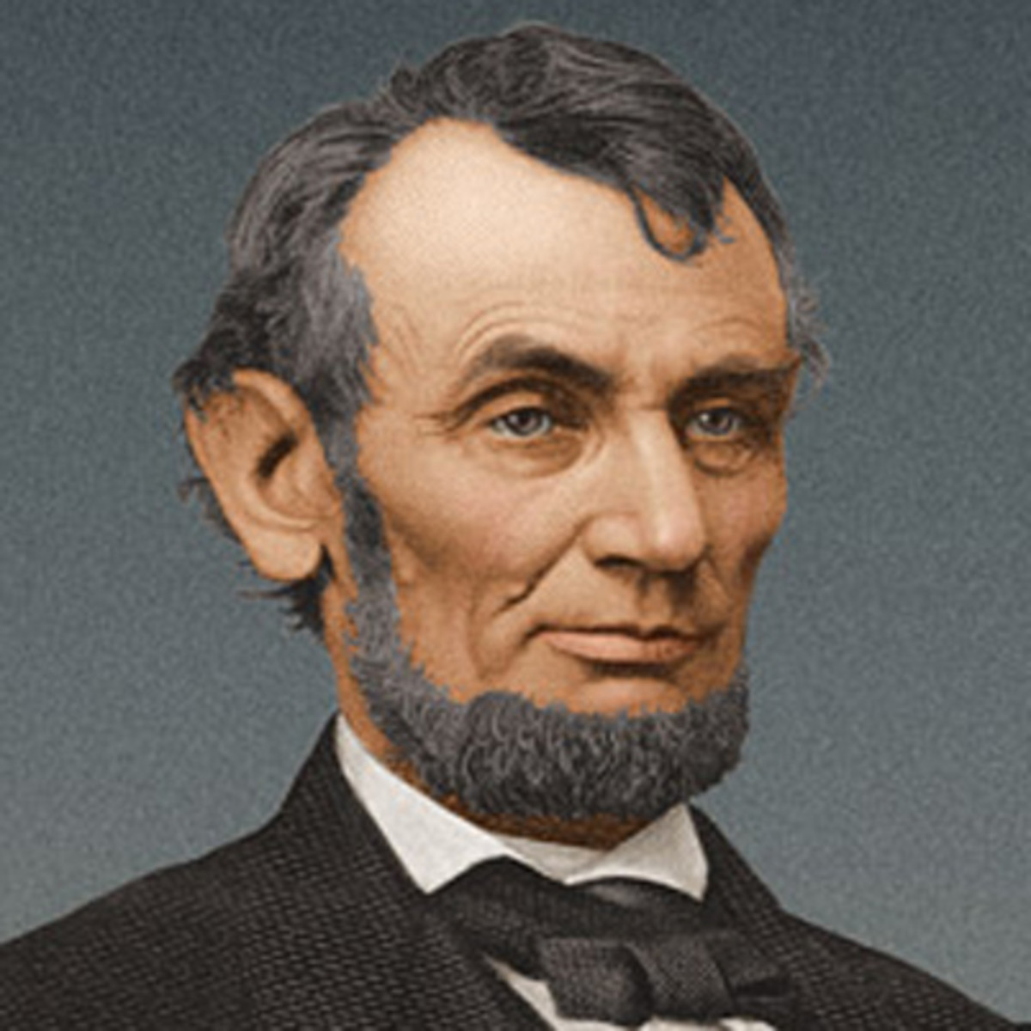
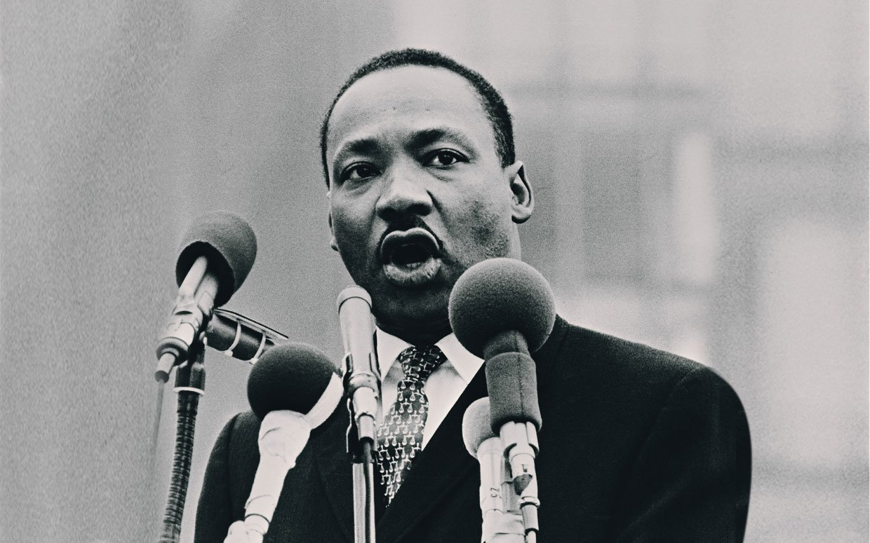
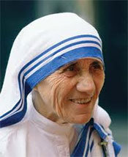
Character

Slide 3
Character
Ordinary
Capital
Tax-exempt

Slide 4
Character
Sale of capital assets results in capital gain or loss
Capital Assets - Anything that is not NOT a capital asset (yup, double-negative)
(1) Inventory
(2) Trade or business property
(3) A copyright, a literary, musical, or artistic composition held by a taxpayer whose personal efforts created such property,
(4) accounts or notes receivable acquired in the ordinary course of trade or business for services rendered or from the sale of inventory;
(5) a publication of the United States Government
(6) any commodities derivative financial instrument held by a commodities derivatives dealer,
(7) any hedging transaction which is clearly identified as such before the close of the day on which it was acquired, originated, or entered into; or
(8) supplies of a type regularly used or consumed by the taxpayer in the ordinary course of a trade or business of the taxpayer.

Slide 5
Character
Ordinary Assets
Assets created or used in a taxpayer’s trade or business
Business assets held for less than a year
Example – Inventory, Accounts Receivable, Machinery and Equipment
If taxpayers sell ordinary assets at a gain, they recognize an ordinary gain that is taxed at ordinary rates
If taxpayers sell ordinary assets at a loss, they deduct the loss against other ordinary income

Slide 6
Character
 | Rates | Limitations
Individuals | Long-term gets 0/15/20% | Net capital losses of up to $3,000 can be deducted against ordinary income. Losses carried forward indefinitely
Corporations | No preferential rates | No net capital loss offset. Can be carried back 3 years and forward 5 years

Slide 7
Character
Corporate | Cap Loss | Ord Loss | Cap Gain | Ord Gain
Operating income | 10,000 | 10,000 | 10,000 | 10,000
Capital Gain/(Loss) | (4,000) |  | 4,000
Ordinary Gain/(Loss) |  | (4,000) |  | 4,000
Taxable income | 10,000 | 6,000 | 14,000 | 14,000
Tax | (2,100) | (1,260) | 2,940 | 2,940
Individual (assume 28%)
Operating income | 10,000 | 10,000 | 10,000 | 10,000
Capital Gain/(Loss) | (4,000) |  | 4,000
Ordinary Gain/(Loss) |  | (4,000) |  | 4,000
Taxable income | 7,000 | 6,000 | 14,000 | 14,000
Tax | (1,960) | (1,680) | 3,400 | 3,920

Slide 8
Character
End of Video T8D

