Slide 1
ACCTG 325 Video T6A
Business Tax Intro

Slide 2
Business Tax Intro
This is the complement (and addition to) individual taxable income
Businesses can be organized in many different ways
Sole proprietor
Corporation
Partnership/LLC
We already know the choice of entity makes a difference but some tax accounting issues crossover all types

Slide 3
Business Tax Intro
Businesses do not have AGI or dependents or exemptions
Taxable income is really just gross income minus deductible business expenses
Fewer parts to break down but transactions are immensely more varying
Sales, returns, leases, interest, dividends, cost of goods sold, inventory, etc…

Slide 4
Business Tax Intro
Corporations | Individuals
Gross Income | Gross Income
Deductions | Deductions for AGI
 | Adjusted Gross Income Deductions from AGI (Standard or Itemized Deductions)
 | QBI Deduction
Taxable Income | Taxable Income
Tax Rate Tax Liability Other Taxes Tax Credits Total Tax | Tax Rate Tax Liability Other Taxes Tax Credits Total Tax

Slide 5
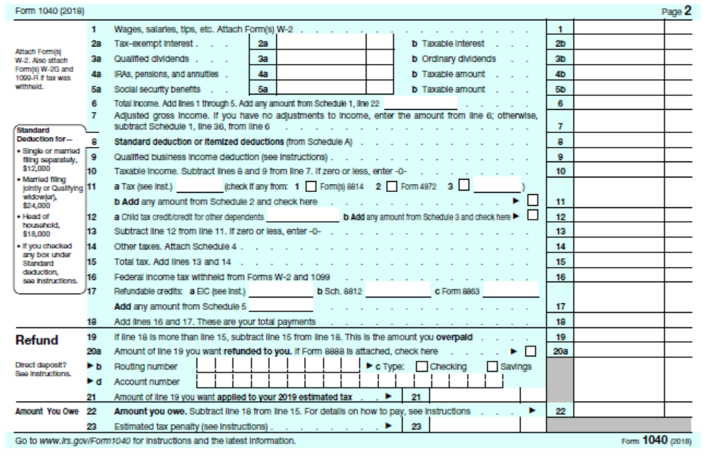
Page 2 of 1040
Common income items
Summary of all else
Refund/Payable

Slide 6
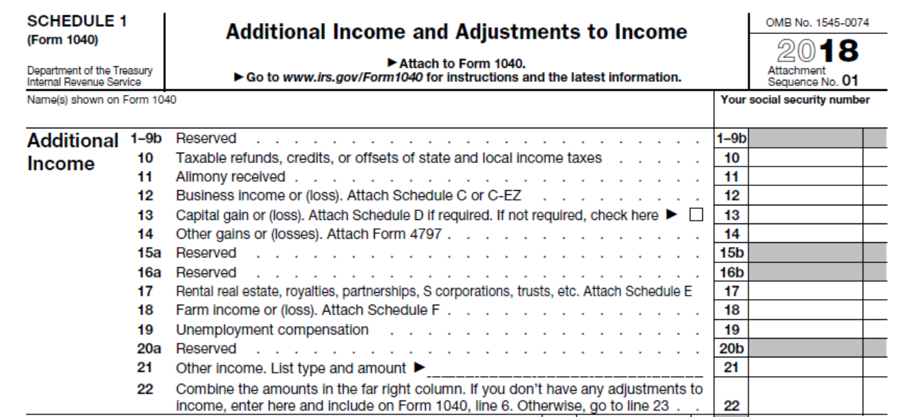
Individual Overview
Schedule 1 Top Section
Other income sources
Pulls from other Schedules

Slide 7
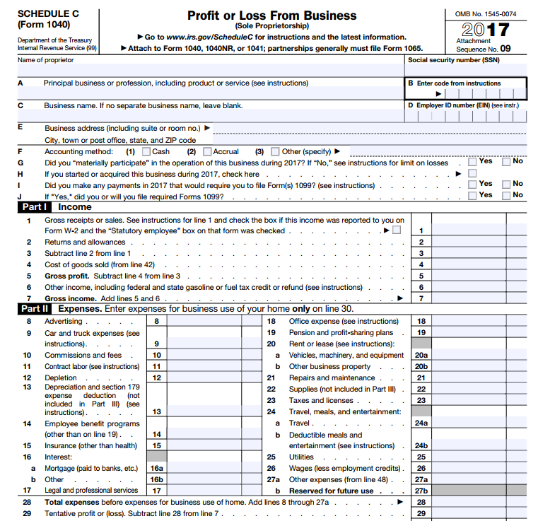
Business Tax intro
Part I – income
Part II - expenses

Slide 8
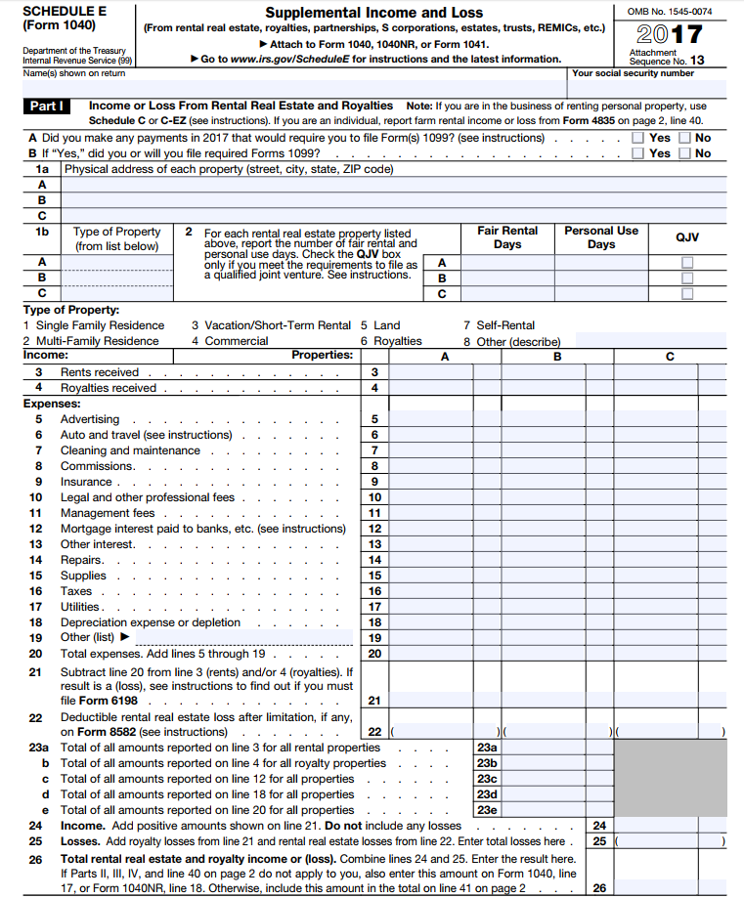
Business Tax intro
Page 1 of Schedule E
Rental real estate
Gross rental income less expenses

Slide 9
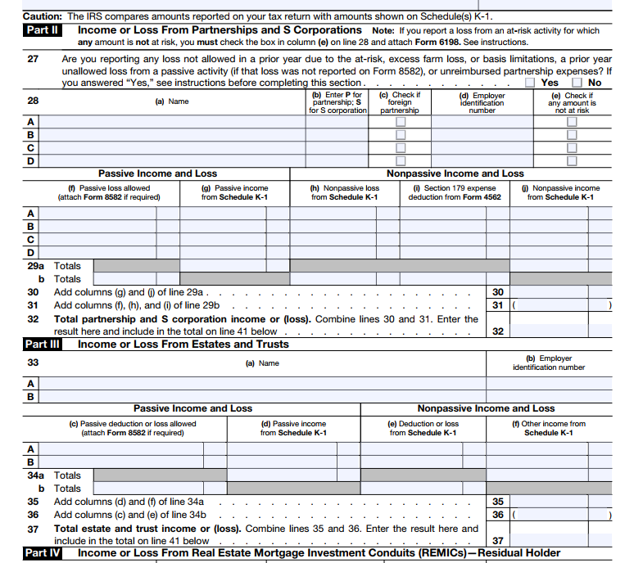
Business Tax intro
Page 2 of Schedule E
Partnerships, S Corps, LLCs and other flow through entities

Slide 10
Business Tax Intro
Gross income: income from whatever source derived
Taxpayers realize and recognize (report) on their tax returns for the year
Income that is excluded or deferred is not included in gross income
Excluded income is never taxed
Deferred income is taxed when recognized in a subsequent year
Gross income includes a deduction for cost of goods sold!
Obviously, if I sell a wiget for $5 that I purchased for $3, my gross income is $2
Gross income is VERY broad – sales, services, rents, royalties, interest, dividends, wages, bonuses, gains, etc.

Slide 11
Business Tax Intro
Deductions: “all ordinary and necessary expenses paid or incurred during the taxable year in carrying on any trade or business”
Also very expansive
Key terms: Ordinary, necessary, business

Slide 12
Business Tax Intro
Income is measured as an activity
Need to capture activity over a period (year)
Individuals: Calendar year
Non-individuals: Fiscal year on any month end
Changing tax year requires IRS permission
Also some limitations on year choice for certain entity-types (e.g. partnership)
Do not worry about short year annualization – leave that to the CPAs

Slide 13
Business Tax Intro
Once a “period” has been selected, then the question of when an item is recognized for tax becomes relevant
timing variable - even one year can make a difference
Chu purchases stock in Facebook for $100. At end of year, stock is worth $120. In March of following year, Chu sells stock for $140
At year end gain is UNREALIZED
In March, gain is REALIZED
Gain is probably also RECOGNIZED (included in gross income)

Slide 14
Business Tax Intro
Tax law generally requires REALIZATION before RECOGNITION
Financial accounting, not so much
Mark to market, etc.

Slide 15
Business Tax intro
Purpose of GAAP: accurate information from which prediction about future performance can be made
Purpose of Tax: Generate revenue for the fisc
Not entirely
Expenses contrary to public policy
Illegal bribes, fines, and penalties
Brand new: settlement of sexual harassment cases which are subject to non-disclosure
Meals and entertainment
The book mentions a domestic production activities deduction – that was repealed

Slide 16
Business Tax intro
End of Video T6A

