Slide 1
ACCTG 325 Video T14E
Individual Tax Rates

Slide 2
QBI Deduction
4 step process to taxable income (follows Form 1040)
Total income
Adjusted gross income
Standard/Itemized Deductions
Qualified Business Income (QBI) deduction
Prof Gill says add two more
Calculate tax
Apply credits and payments

Slide 3
Individual Tax Rates
Step 5: Using applicable filing status, compute tax
For income < $100,000, must use tax tables
For income $100,000+, must use tax rate schedules
What we have been using until now

Slide 4
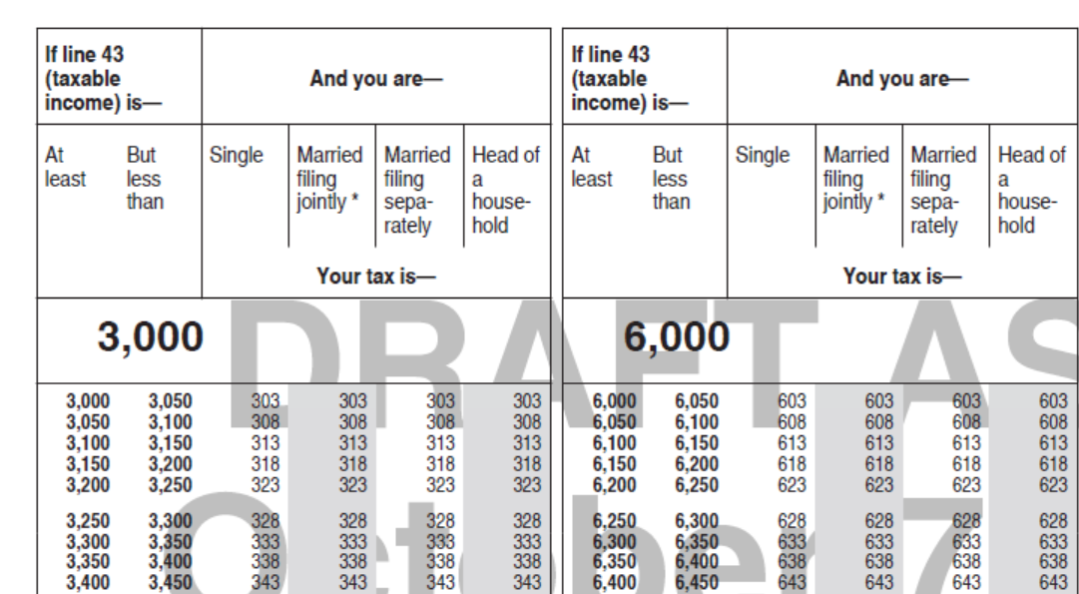
Individual Overview

Slide 5
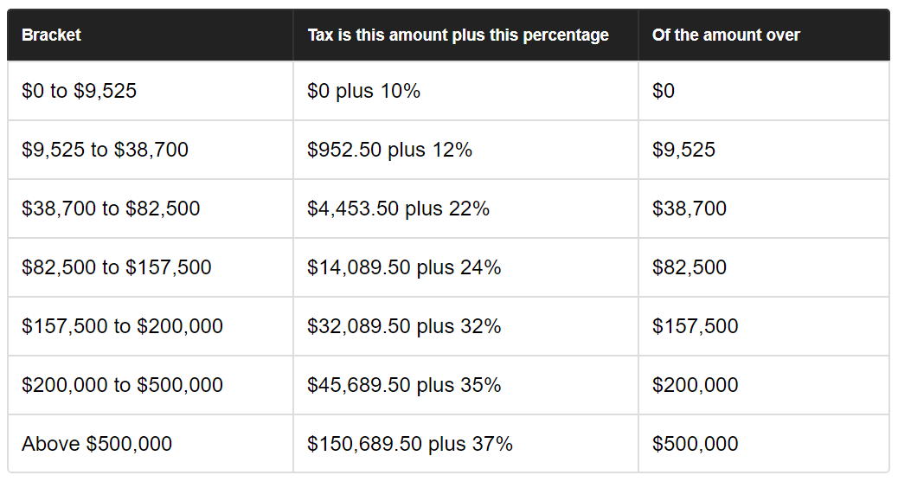
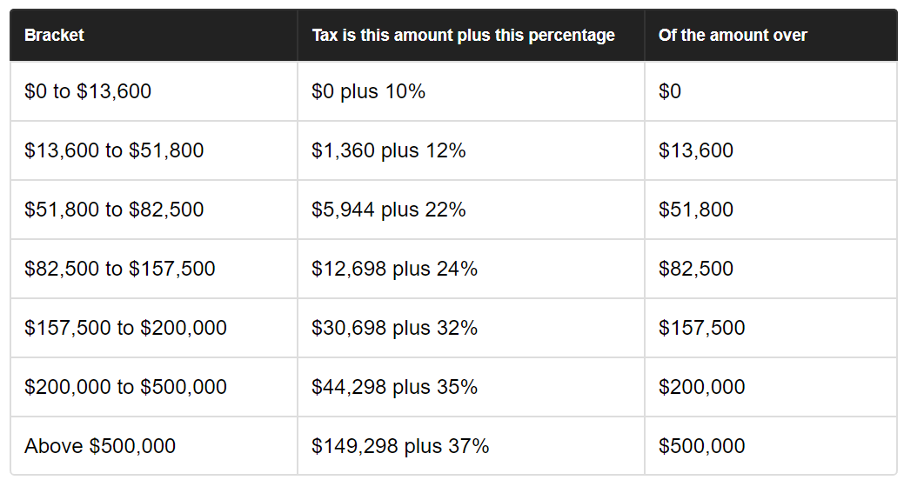
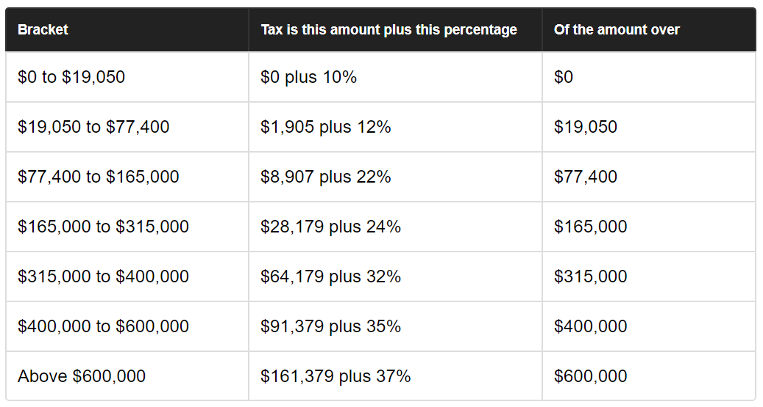
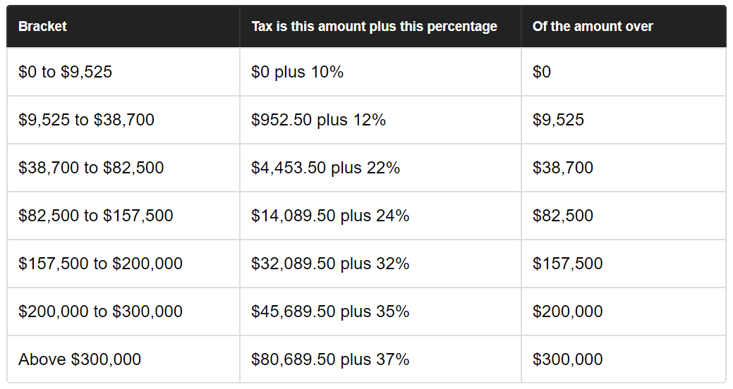
Individual Tax Rates
Single
Head of Household
Married filing joint
Married filing separately

Slide 6
Individual Tax Rates
Recall that the Character of income can create preferential tax rates
LT capital gains & Qualified dividends 0/15/20%
When income character is not ordinary, the tax rate computation is more complex

Slide 7
Individual Tax Rates
Betty has $88,000 of taxable income
Wages $87,000
LT capital gains $13,000
Standard deduction $12,000
Wages | 87,000
LTCG | 13,000
AGI | 100,000
Standard deduction | (12,000)
Taxable income | $88,000
Total | LTCG | Ordinary
88,000 | 13,000 | 75,000

Slide 8
Individual Tax Rates
Total | LTCG | Ordinary
98,000 | 13,000 | 85,000
Tax on ordinary income
$75,000 - $38,700 = $36,300
$36,300 x 22% = $7,986
$7,986 + $4,453.50 = $12,439.50

Slide 9
Individual Tax Rates
Total | LTCG | Ordinary
98,000 | 13,000 | 85,000
Tax on preferential income (LTCG)
$13,000 x 0%?
First must consider all ordinary income!
LTCG income is increment from $75,000 to $88,000
Tax is $13,000 x 15% = $1,950
Total tax
$12,439.50 + $1,950 = $14,389.50

Slide 10
Individual Tax Rates
What about a taxpayer in lower ordinary tax rates?
Veronica has $20,000 of taxable income
Wages $19,000
LT capital gains $13,000
Deductions and exemptions $12,000
Ordinary income = $7,000; LT cap gain = $13,000
Wages | 19,000
LTCG | 13,000
AGI | 32,000
Standard deduction | (12,000)
Taxable income | $20,000
Total | LTCG | Ordinary
20,000 | 13,000 | 7,000

Slide 11
Individual Tax Rates
Total | LTCG | Ordinary
20,000 | 13,000 | 7,000
Tax on ordinary income
$7,000 x 10% = $700

Slide 12
Individual Tax Rates
Total | LTCG | Ordinary
20,000 | 13,000 | 7,000
Tax on preferential income (LTCG)
$13,000 x 0%?
First must consider all ordinary income!
LTCG income is increment from $7,000 to $20,000
Tax is $13,000 x 0% = $0
Total tax
$700 + $0 = $700

Slide 13
Individual Tax Rates
Interaction of AGI and deductions can cause marginal rate to “float” in less predictable ways
Archie has gross income of $102,500; itemized deductions of $42,500 that includes a $22,500 medical expense deduction ($30,000 in total medical expenses)
If Archie makes an investment and earns an additional $10,000, what is the after tax effect?
$10,000 x (1-tax rate)
$60,000 of taxable income puts him in 22% bracket, so $7,800
Wages | 102,500
AGI | 102,500
Itemized deductions | (42,500)
Taxable income | $60,000

Slide 14
Individual Tax Rates
Increase in tax = $2,365
Increase in ATCF = $7,635 not $7,800
MTR short cut did not work due to interaction between income and deduction
Gross income | 102,500 | 112,500
Medical expenses | 30,000 | 30,000
Medical Floor | 7,500 | 8,250
Medical deduction | 22,500 | 21,750
Other deductions | 20,000 | 20,000
Taxable income | 60,000 | 70,750
Tax | 9,140 | 11,505

Slide 15
Individual Tax Rates
End of Video T14E

