Slide 1
ACCTG 325 Video T14C
Standard and Itemized Deductions

Slide 2
Deductions
4 step process to taxable income (follows Form 1040)
Total income
Adjusted gross income
Standard/Itemized Deductions
QBI deduction
Prof Gill says add two more
Calculate tax
Apply credits and payments

Slide 3
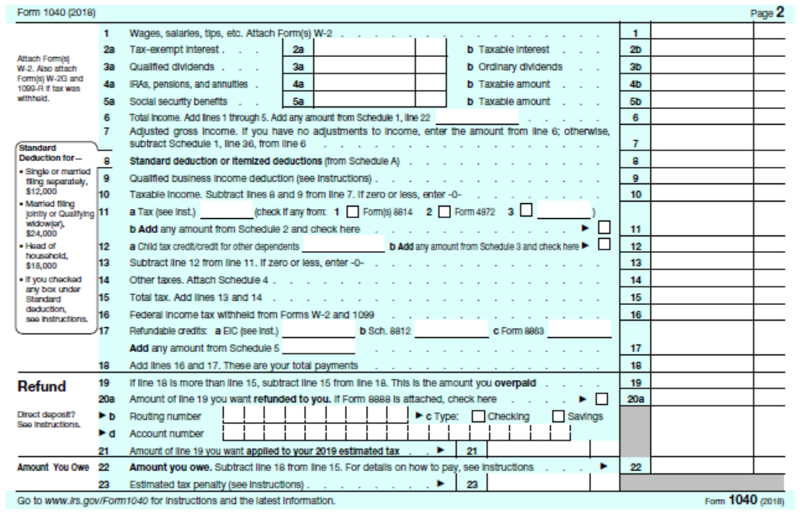
Deductions
Line 8: Itemized deductions or standard deduction

Slide 4
Deductions
Standard Deduction – an amount each taxpayer may deduct depending on filing status
Itemized Deductions – the total of the qualifying deductions a taxpayer may use in lieu of the standard deduction
You can deduct the larger of these two!

Slide 5
Individual Overview
Standard Deductions
Filing Status | 2019 | 2018 | 2017 | 2016 | 2015 | 2014 | 2013
Married Filing Jointly | $24,400 | $24,000 | $12,700 | $12,600 | $12,600 | $12,400 | $12,200
Married Filing Separately | 12,200 | 12,000 | 6,350 | 6,300 | 6,300 | 6,200 | 6,100
Head of household | 18,350 | 18,000 | 9,350 | 9,300 | 9,250 | 9,100 | 8,950
Single | 12,200 | 12,000 | 6,350 | 6,300 | 6,300 | 6,200 | 6,100

Slide 6
Deductions
Jane is 25, single, and has income of $80,000
Julie is 68, single, blind, and has only her social security income of $32,000
Standard deduction is $X for both……..?
Additional standard deduction amount if age 65+ or blind
Fairness?
Filing Status | 2019 | 2018 | 2017 | 2016 | 2015 | 2014 | 2013
Married | $1,300 | $1,300 | $1,250 | $1,250 | $1,250 | $1,200 | $1,200
Head of household and single | 1,650 | 1,600 | 1,550 | 1,550 | 1,550 | 1,550 | 1,500

Slide 7
Deductions
Remember Dentist that shifted income to daughter?
When a taxpayer is claimed as a dependent on someone else’s return, the standard deduction is limited
Otherwise, shift income of single standard deduction amount to each child and create tax-exempt income!
Limit is $1,100 or earned income + $350 (up to that year’s standard deduction amount)

Slide 8
Deductions
In 2018, Melissa is single, 20, a full-time student, and claimed as a dependent by her parents.
Melissa has a part-time job that pays her $_____ per year. What is Melissa’s standard deduction if she makes
$500
$5,000
$11,800

Slide 9
Deductions
Limit is $1,100 or earned income + $350 (up to that year’s standard deduction amount)
$500
$1,100 or $850 ($500+$350)
$5,000
$1,100 or $5,350
$11,800
$1,100 or $12,150 BUT limited to $12,000 (single standard deduction in 2018)

Slide 10
Deductions
We spent 7 slides on the standard deduction!
And frankly, did not do it justice
Itemized deductions
Short list of personal expenses and losses that Congress lets individuals deduct
Use Schedule A to Form 1040

Slide 11
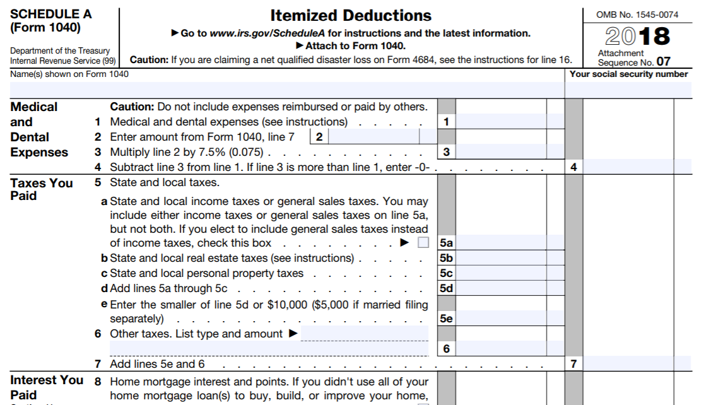
Deductions
Details are reported on Schedule A
Total carried to Form 1040

Slide 12
Deductions - 2018
Medical expenses – fairness (limited by % AGI)
Taxes – Tax expenditure (limited to $10,000 per return)
Interest – Tax expenditure (limited on amt. of debt)
Charitable contributions – Tax expenditure (limited by % AGI)
Casualty losses – fairness (limited by % AGI and only for federal disasters)
Misc Deductions – those limited by AGI are repealed

Slide 13
Deductions
Medical
Must exceed floor of 7.5% in 2018
Works like casualty loss to capture “significant” medical expenses
Barb’s AGI is $50,000 and she incurs $5,500 of qualified medical expenses
$50,000 x 7.5% = $3,750 floor
$5,500 - $3,750 = $1,750 medical expense deduction

Slide 14
Deductions
Taxes
State income tax OR state sales and use tax
Property taxes
Real and personal
Auto taxes (if based on value)
Limit in total is $10,000 (2018)

Slide 15
Deductions
Interest
Qualified home mortgage interest
Interest on first $1 million of qualified home debt (2018 $750,000)
Interest on up to $100,000 of home equity loan (repealed in 2018)
Can have up to two homes
Investment interest
Personal interest (auto, credit cards, etc.) NOT deductible
Take home equity loan to purchase car! (not any more)

Slide 16
Deductions
Charitable donations
Must be to organizations
Can’t be to homeless guy on street
Generally, limited to 50% of AGI (60% if cash)
Other limitations on different types of property donated
Janelle (30% MTR) owns stock she purchased for $10 and is now worth $100
She also wants to make a donation
Sell and generate $86.50 – make $$ donation reducing tax by $26
Donate stock and take FMV as deduction saving tax of $30

Slide 17
Deductions
Casualty and theft losses – only deductible if related to federally declared disaster
Misc expenses
Unreimbursed employee business expenses no longer deductible

Slide 18
Deductions
If standard deduction hovers around $24,000 for a MFJ, when does one itemize?
Typically, after home purchase
$400,000 mortgage at 5% = $20,000 interest
$400,000 value x 1.5% for property tax = $6,000 in property taxes
Itemization begins
Ella has taxable income of $30,000 and rents. She makes a charitable contribution to American Cancer Society of $2,000 after her father dies from cancer
Probably not deductible

Slide 19
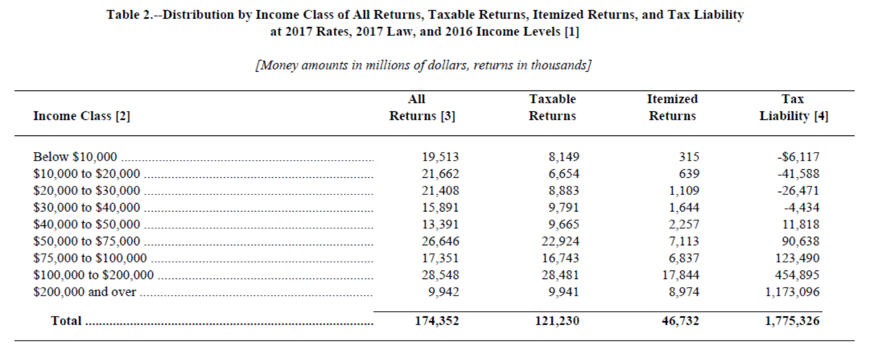
Deductions

Slide 20
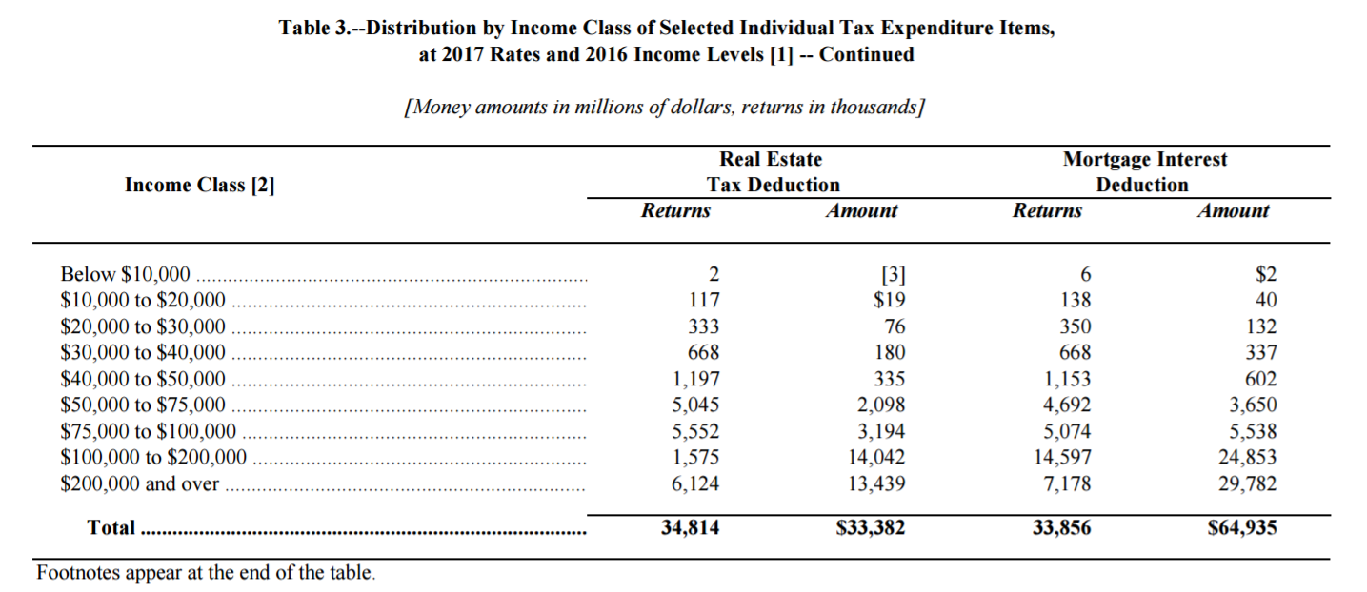
Deductions
Insert slide on “who takes deductions” by income level using JCT Tax expend info
% of tax returns filed
<1
<1
2
4
9
19
32
6
62

Slide 21
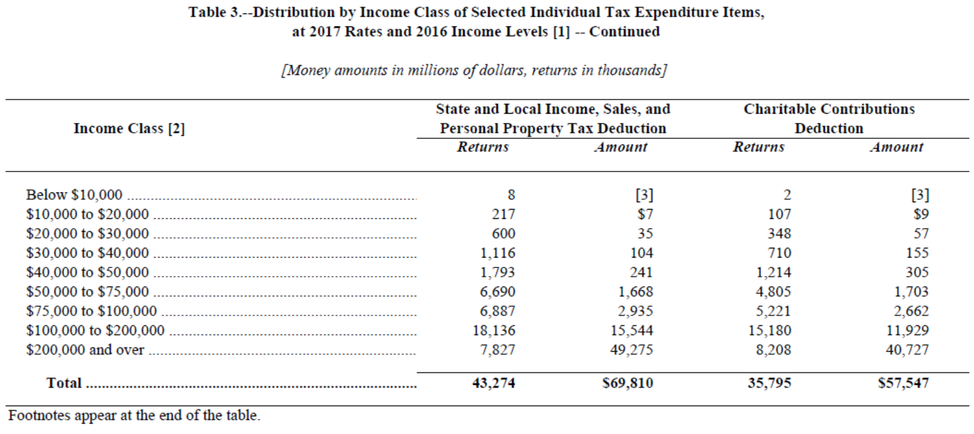
Deductions

Slide 22
Deductions
Timing of itemized deductions
No taxpayer wants to have $1 less of itemized deductions than the standard deduction!
Can time deductions to take advantage of interplay between standard and itemized
Charitable contributions is easiest
Taxes also somewhat (make state income tax payment by Dec 31)
Cannot generally time interest, medical, or casualty losses

Slide 23
Deductions
End of Video T14C

