Slide 1
ACCTG 325 Video T7C
Cost Recovery

Slide 2
Cost recovery
This video is full of computations
Get your calculator ready
You will also need access to the depreciation tables in your text
They can also be found on the internet
Take the time to stop the video and work out the solutions also
You will see them again on quiz and exam

Slide 3
Cost recovery
Tangible business property
Machines, equipment, computers, cars, trucks, furniture, buildings
Cost are recovered using depreciation
Before we get too far
Real property – real estate (buildings, land and things attached to it)
Personal property – tangible property that is not real property
Personal use property – property used for personal (not business) and could be real or personal

Slide 4
Cost recovery
Depreciation
Before 1981, tax depreciation methods closely resembled financial accounting methods which required businesses to determine “Salvage Values” and “Useful Lives”
In 1981, ACRS – Accelerated Cost Recovery System was introduced to depreciate assets over predetermined, fixed recovery periods of less than the useful life
Today, businesses calculate their tax depreciation using the MACRS- Modified Accelerated Cost Recovery System which is pronounced “makers” by tax accountants

Slide 5
Cost recovery
Starts when the asset was “placed into service” NOT the date it was purchased.
The Trump Company started construction of a tower and has incurred costs of $30,000,000. Much of the tower is complete; however, only the first three floors have received a permit to occupy. How should Trump determine the basis and depreciation?
For items such as a building which may have a portion of the total assets enter into service, only that portion is allowed a depreciation deduction.
Determine the cost of the first three floors and depreciate only that cost

Slide 6
Cost recovery
IRS Method
To calculate tax depreciation you must know:
The depreciation system (GDS v. ADS)
Property class (3,5,7,…Residential Real, Non-residential real)
Placed in service date
Basis amount
Recovery period (3,5,7,…27.5, 39)
Convention (Mid-qtr, mid-month, half-year)
Depreciation method (200% DB, 150% DB, SL)

Slide 7
Cost recovery
What is the proper table?
IRS publishes MACRS tables that list the % of cost that is to be recovered through depreciation each year
We are going to use 7 primary tables
Personal property half-year convention
Personal property mid-quarter convention Q1
Personal property mid-quarter convention Q2
Personal property mid-quarter convention Q3
Personal property mid-quarter convention Q4
Real property – residential
Real property – nonresidential
Are there other tables? Yes!
Personal property tables
Real property tables

Slide 8
Cost recovery
Depreciation for tax is prescribed
Very little wiggle room
Just use the tables period

Slide 9
Cost recovery
Conventions
Property | In service date | # days in 2017
Furniture | January 14, 2017 | 351 days
Truck | March 21, 2017 | 286 days
Machine | June 1, 2017 | 214 days
Computer | August 11, 2017 | xxx days
Car | October 3, 2017 | xxx days

Slide 10
Cost recovery
Typical computation for personal property
Furniture, 7 year, double declining balance
$100 ÷ 7 x 200% x 351/365 = $27.48
You all remembered how that works, right?
You’ll also remember to prorate by the right number of days in the last year of depreciation, right?

Slide 11
Cost recovery
Need a convention to make things easier
General rule: ½ year convention
All personal property placed in service will take ½ year’s depreciation in the first year
Exception rule: if more than 40% placed in service in 4th quarter must use the mid-quarter
Take ½ of a quarter’s depreciation for quarter placed in service
$100 ÷ 7 x 200% x 1/2 = $14.29

Slide 12
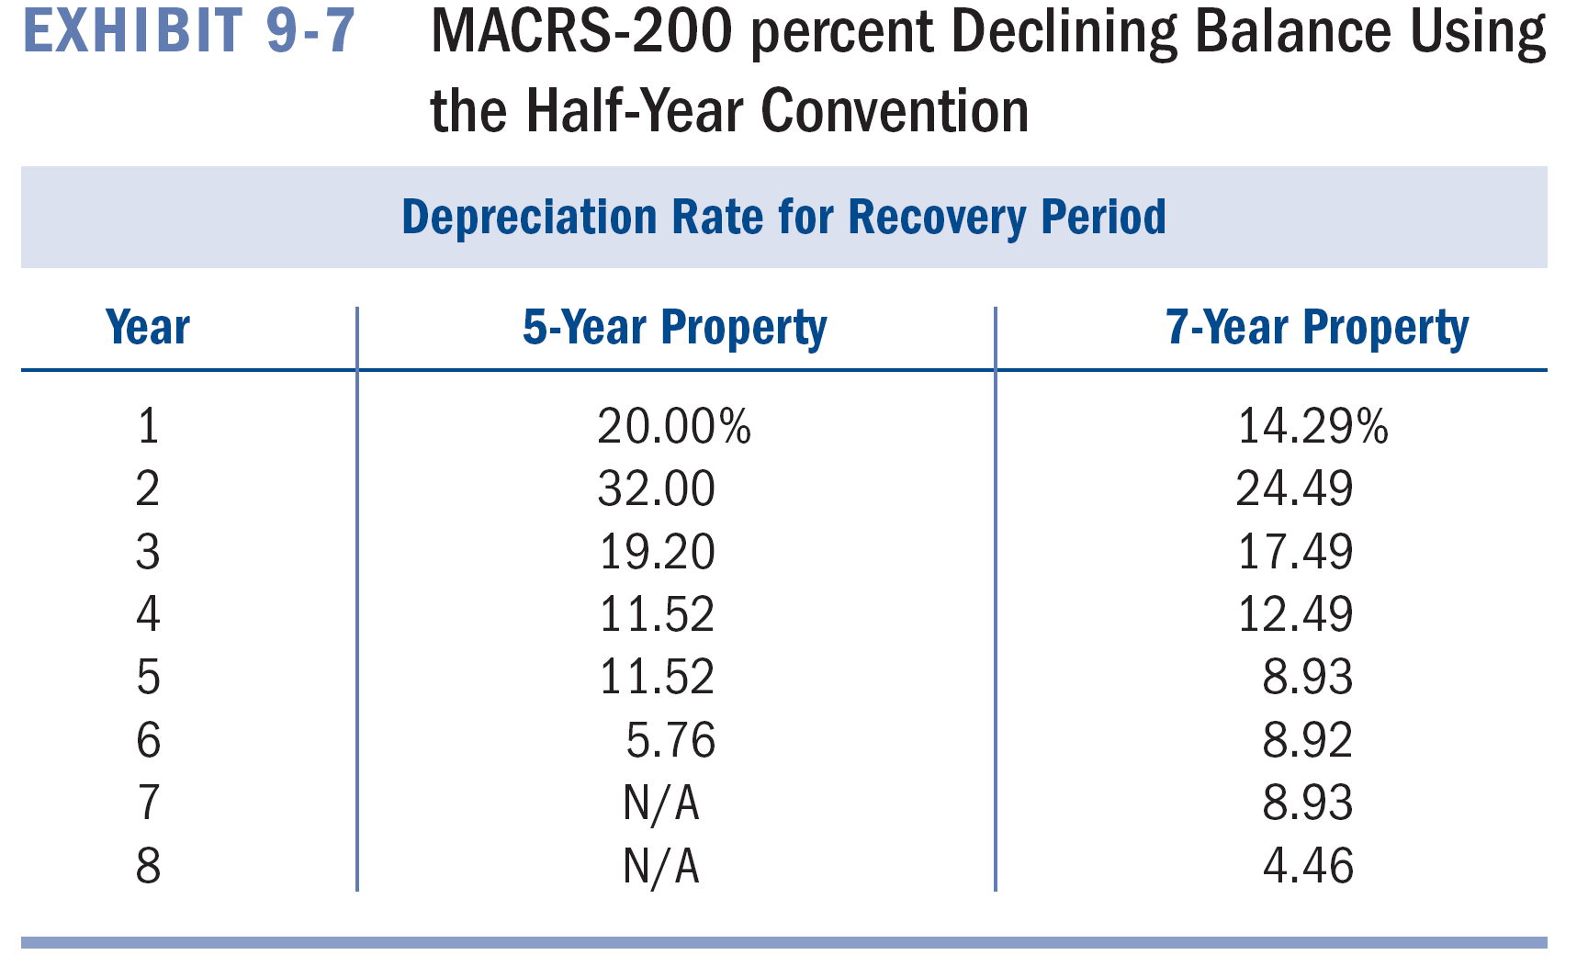
Cost recovery
Still too much work!
IRS provides tables

Slide 13
Cost recovery
It’s late in 2017, and Joe’s Garage is looking back at 2017 assets purchases. Thus far in 2017 Mom bought the following assets:
It’s December 12th and Mom is strongly considering purchasing one more piece of seven-year property for $4,000 that she would put into service tomorrow.
Part I: Calculate Mom’s depreciation allowable using the proper convention and assume she buys the new equipment on 12/12. Ignore Section 179 and bonus depreciation.
In Service Date | Tangible Pers Prop | Cost (Adj Basis) | Recovery Period
07/15/17 | Tire Balancer | 7,000 | 7
07/05/17 | Testing Equipment | 14,000 | 7
05/12/17 | Computer | 3,000 | 5
01/22/17 | Copier | 1,500 | 5
10/13/17 | Other Equipment | 14,000 | 7

Slide 14
Cost recovery
Convention test
Gotta’ find the right table(s)
In service | Asset | Basis | Recovery Period
1/22/2017 | Copier | $1,500 | 5
5/12/2017 | Computer | 3,000 | 5
7/05/2017 | Testing Equip | 14,000 | 7
7/15/2017 | Tire Balancer | 7,000 | 7
10/13/2017 | Other Equip | 14,000 | 7
12/12/2017 | New Equip | 4,000 | 7
 |  | 43,500
Assets purchased during 4th quarter
=14,000+4,000=18,000
Total Assets purchased=43,500
18,000 ÷ 43,500=41%
> 40% so mid-quarter convention

Slide 15
Cost Recovery
Start with the copier
What is the convention? Midmonth
What is the quarter placed in service? 1st quarter
What is the recovery period? 5 years
Copier cost $1,500 x 35% = $525 depreciation in 2017

Slide 16
Cost Recovery
How about the computer
What is the convention? Mid quarter
What is the quarter placed in service? 2nd quarter
What is the recovery period? 5 years
Computer cost $3,000 x 25% = $750 depreciation in 2017

Slide 17
Cost recovery
Rest of the assets
In service | Asset | Recovery Period | Basis | Depreciation Factor | 2009 Depreciation
1/22/2017 | Copier | 5 | $1,500 | .35 | 525.00
5/12/2017 | Computer | 5 | 3,000 | .25 | 750.00
7/05/2017 | Testing Equip | 7 | 14,000 | .1071 | 1,499.50
7/15/2017 | Tire Balancer | 7 | 7,000 | .1071 | 749.70
10/13/2017 | Other Equip | 7 | 14,000 | .0357 | 499.80
12/12/2017 | New Equip | 7 | 4,000 | .0357 | 142.80
 |  |  | 43,500 |  | 4,166.70

Slide 18
Cost Recovery
What if Mom does not buy the asset?
In service | Asset | Basis | Recovery Period
1/22/2017 | Copier | $1,500 | 5
5/12/2017 | Computer | 3,000 | 5
7/05/2017 | Testing Equip | 14,000 | 7
7/15/2017 | Tire Balancer | 7,000 | 7
10/13/2017 | Other Equip | 14,000 | 7
 |  | 39,500
Assets purchased during 4th quarter
=14,000=14,000
Total Assets purchased=39,500
14,000 ÷ 39,500=35%
< 40% so half-year convention

Slide 19
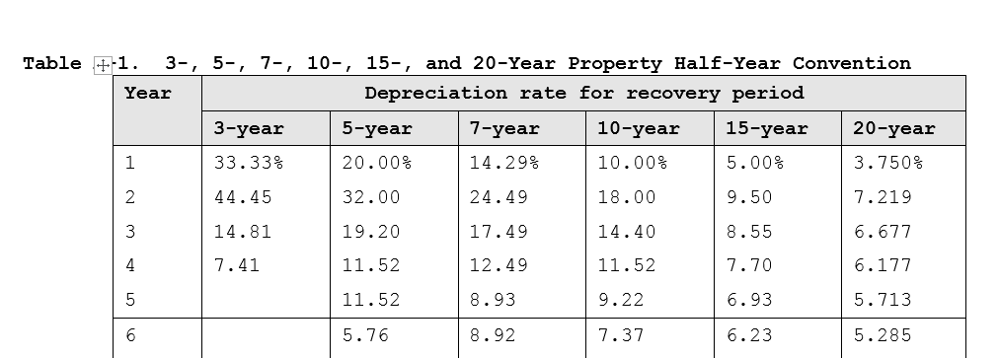
Cost Recovery
Copier $1,500 x .20 = $300
Computer$3,000 x .20 = $600
Now do rest of property

Slide 20
Cost Recovery
Cost recovery is actually MORE if she does not buy the equipment!
$5,900 v $4,167
In service | Asset | Recovery Period | Basis | Depreciation Factor | 2009 Depreciation
1/22/2017 | Copier | 5 | $1,500 | .20 | $300.00
5/12/2017 | Computer | 5 | 3,000 | .20 | 600.00
7/05/2017 | Testing Equip | 7 | 14,000 | .1429 | 2,000.00
7/15/2017 | Tire Balancer | 7 | 7,000 | .1429 | 1,000.00
10/13/2017 | Other Equip | 7 | 14,000 | .1429 | 2,000.00
 | New Equip |  | 0
 |  |  | 39,500 |  | $5,900.00

Slide 21
Cost Recovery
Let’s do Year 2!
Copier: 32% of what?
Original depreciable basis! The table takes care of DDB
$1,500 x 32% = $480
Computer $3,000 x 32% = $960

Slide 22
Cost Recovery
March down the table
Once you start in a column you never leave that column (for that asset)

Slide 23
Cost Recovery
A couple of things worth noting
Because of the half-year convention, a 5 year asset actually takes 6 years to depreciate for tax, a 7 year asset takes 8 years, etc.
It’s true – look at the table
The table takes care of the convention in the first year and all other years UNLESS you dispose of the asset before the end of it’s useful life
Mathematical proof: $1 asset with a 5 year life
Year 1: $1 ÷ 5 x 200% x ½ = 20%......does that agree to the table?
Year 2: (remember, double-declining balance) $.80 ÷ 5 x 200% x 1 = 32%....does that agree to the table?
Year 3: $.48 ÷ 5 x 200% x 1 = 19.2%....it does, trust me
Year 4: $.288 ÷ 5 x 200% x 1 = 11.52%....did you even check the previous ones? I bet not!
Year 5: $.1728 ÷ 5 x 200% x 1 = 6.912%....wait…if you haven’t been checking, how would you know that this does NOT agree to the table?
The MACRS system switches to straight line when it is more advantageous to do so
Year 5 Re-do: $.1728 ÷ 1.5 years remaining = 11.52%

Slide 24
Cost Recovery
Real property
Because amounts tend to be large and lives are longer, the half-year/mid-quarter convention do NOT apply to real property
Instead, the mid-month convention is used (table does all the heavy lifting)
Note a column for each month
Example: Michelle places in service an apartment in May, 2017 at a cost of $100,000
$100,000 x 2.273% = $2,273
Those late in the year factors are decimals of percentages
$100,000 x .455% is same as $100,000 x .00455 and = $455 NOT $45,500
Wrong $%#@ table!

Slide 25
Cost Recovery
How does real property affect the convention test?
It does not. Ignore real property in both the numerator and denominator of the test
Beth placed in service the following:
Convention test: $0/$110,000
Real property is ignored
It’s on mid-month anyway!
Date | Asset | Recovery | Amount
2/14/2017 | Furniture | 7 | $50,000
7/12/2017 | Machine | 7 | $60,000
11/23/2017 | Building | 39 | $540,000

Slide 26
Cost Recovery
So the table automatically builds in either ½ year or ½ quarter or ½ month for the year, quarter or month placed in service – how convenient
What about disposals?
When an asset is sold whatever convention applied on the year of purchase will also apply in the year of disposal.
If half-year going in, then half-year coming out
If mid-quarter going in, then mid-quarter going out
If mid-month going in, then mid-month coming out

Slide 27
Cost Recovery
Gordon Sumner placed in service a 7 year asset in 2015 costing $10,000 for use in trade or business. No bonus depreciation or Sec. 179 deduction was taken and the half-year convention was used. He sold the asset on January 1, 2017. What is the depreciation deduction in 2017?
Smooth sailing until we get to year of disposal!
If half-year convention applied during Year 1, it must also apply during Year 3
$10,000 x .1749 x ½ = $874.50
2015
2016
2017

Slide 28
Cost Recovery
Stewart Copeland placed in service a 7 year asset in 2015 costing $10,000 for use in trade or business. No bonus depreciation or Sec. 179 deduction was taken and the mid-quarter convention was used (assume 3rd qtr). He sold the asset on January 1, 2017. What is the depreciation deduction in 2017?
Wait! Sold in first quarter, should we switch to the Q1 Table?
Hell no! Once in a column, stay in a column $10,000 x .1822 x .5/4 = $227.75

Slide 29
Cost Recovery
Applying the convention to the disposal is a very common mistake so let’s go over some iterations
$10,000 asset, 7 year, placed in service 3 years ago and disposed of this year in Q1
$10,000 x .1822 x .5/4 = $227.75
$10,000 asset……disposed of in Q2.
$10,000 x .1822 x 1.5/4 = $683.25
Etc…..
Q1 | Q2 | Q3 | Q4
1/2
0
0
0
Q1 | Q2 | Q3 | Q4
1
1/2
0
0

Slide 30
Cost recovery
End of Video T7C

