Slide 1
ACCTG 325 Video T14A
Filing Status

Slide 2
Filing status
Horizontal equity
Those in the same position should pay the same tax
Does a married couple have the same income and cost structure as two single individuals?
Income could be same (if both work)
Expenses?
Married couple likely to share cost of shelter and related
Single less likely to share cost of shelter
How about someone who’d spouse died during the year – single or married?
What about a single parent?
Filing status is a way of taking into consideration that even if all the incomes are the same, the ability to pay differs

Slide 3
Filing status
Married
Married filing jointly (treated as if income is pooled and costs are shared)
Married filing separately (treated as if income is separate and costs are cut in half)
Surviving spouse
Spouse dies
In year of death, can MFJ
Up to two years if have a dependent child

Slide 4
Filing status
Unmarried
Single (just like it sounds)
Head of Household
Single taxpayer with dependent (e.g., child or aged parent)
Provides for decreased tax compared to single

Slide 5
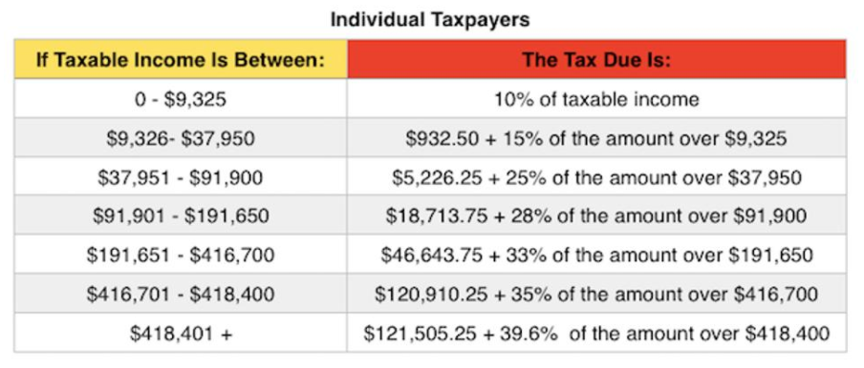
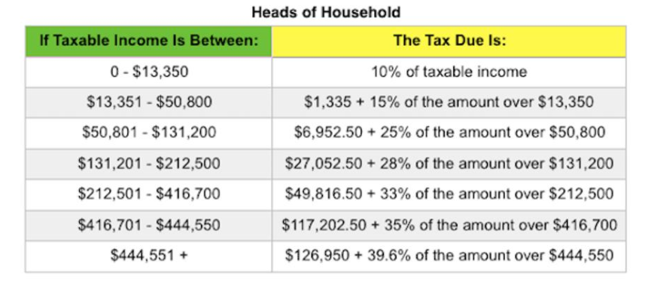
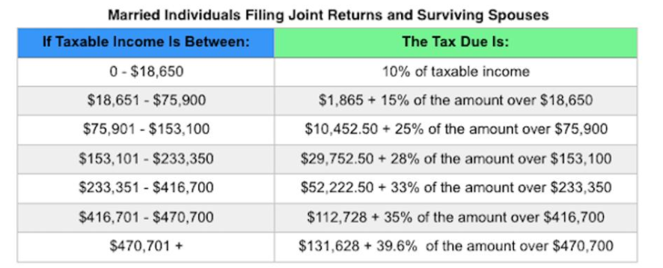
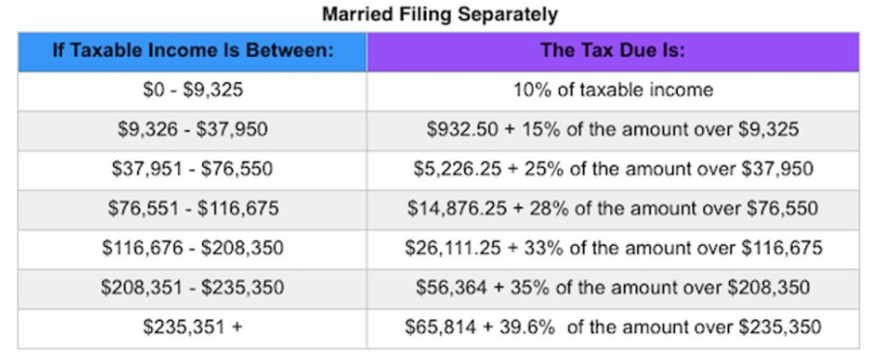
Filing status
Use different tax rate schedules (Appendix C of textbook)

Slide 6
Filing status
Taxpayer A is single and has taxable income of $50,000
Taxpayer B is head of household status with $50,000 income
Taxpayers C is married filing jointly with $50,000 income
Taxpayers D is married filing separately with $50,000 income
A: [($50,000 - $37,950) x 25%] + $5,226.25= $8,238.75
B: [($50,000 - $13,350) x 15%] + $1,335.00 = $6,832.50
C: [($50,000 - $18,650) x 15%] + $1,865.00 = $6,567.50
D: [($50,000 - $37,950) x 25%] + $5,226.25 = $8,238.75

Slide 7
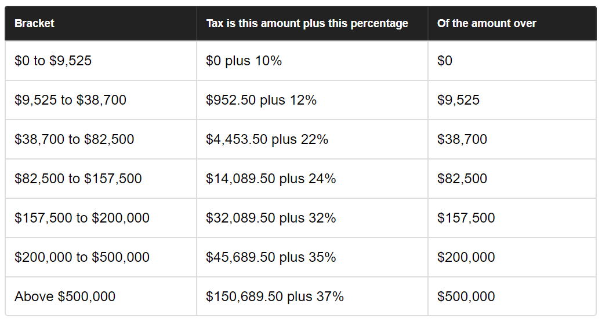
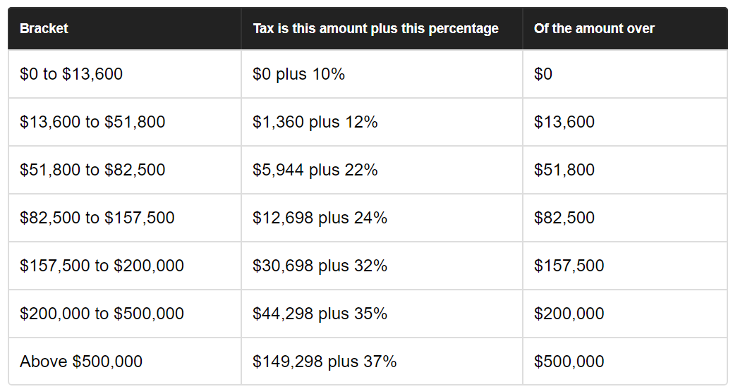
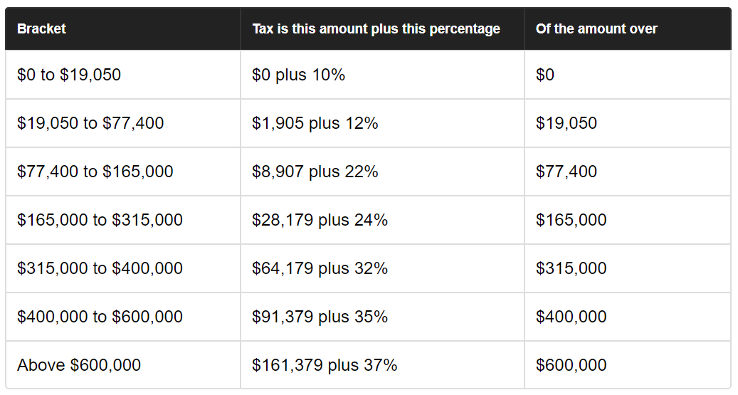
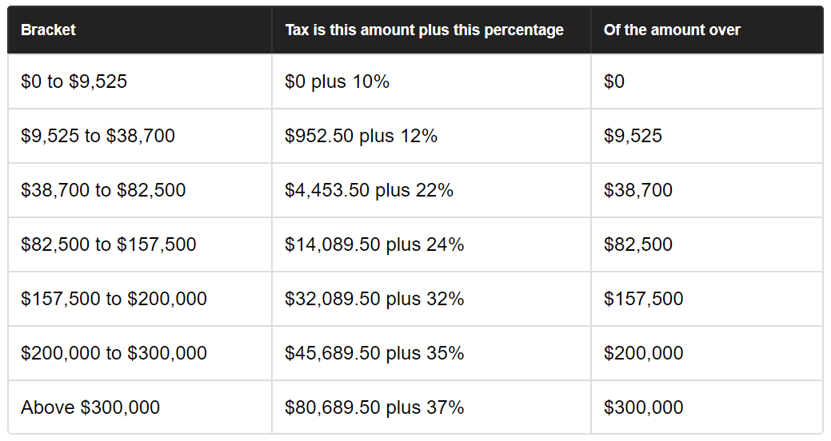
Filing Status – new tax tables
Single
Head of Household
Married filing joint
Married filing separately

Slide 8
Filing status
Taxpayer A is single and has taxable income of $50,000
Taxpayer B is head of household status with $50,000 income
Taxpayers C is married filing jointly with $50,000 income
Taxpayers D is married filing separately with $50,000 income
A: [($50,000 - $38,700) x 22%] + $4,453.50= $6,939.50 ($8,238.75)
B: [($50,000 - $13,600) x 12%] + $1,360.00 = $5,728.00 ($6,832.50)
C: [($50,000 - $19,050) x 12%] + $1,905.00 = $5,619.00 ($6,567.50)
D: [($50,000 - $38,700) x 22%] + $4,453.50 = $6,939.50 ($8,238.75)

Slide 9
Filing status
Taxpayer A is single and has taxable income of $250,000
Taxpayer B is head of household status with $250,000 income
Taxpayers C is married filing jointly with $250,000 income
Taxpayers D is married filing separately with $250,000 income
 | 2017 | 2018 | Difference
A | 65,899.25 | 63,189.50 | (2,709.75)
B | 62,191.50 | 61,798.00 | (393.50)
C | 57,717.00 | 48,579.00 | (9,138.00)
D | 70,941.50 | 63,189.50 | (7,752.00)

Slide 10
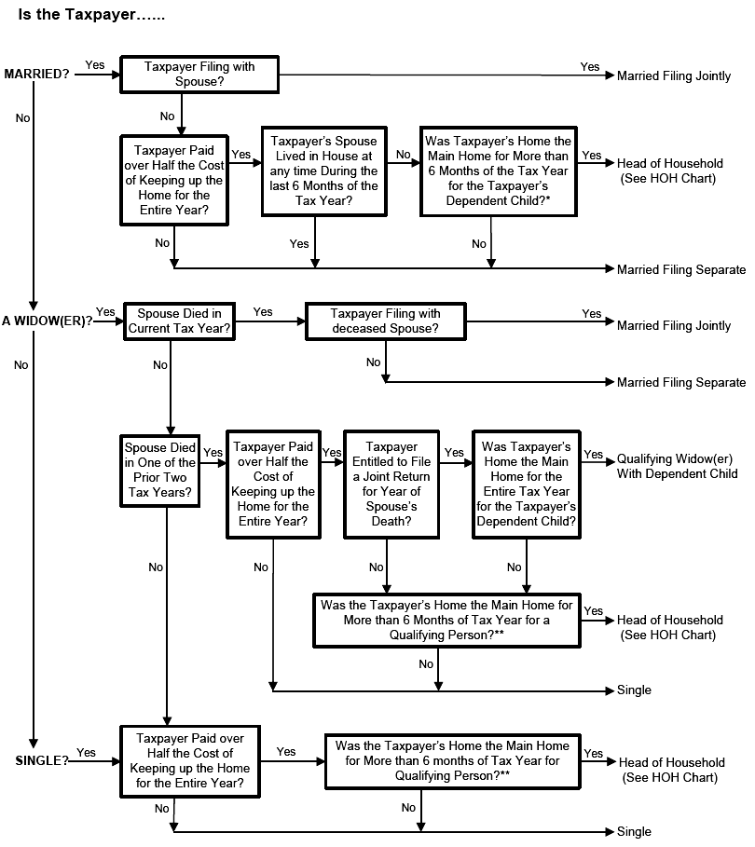
Filing status
Filing status flowchart

Slide 11
Filing Status
End of Video T14A

