Slide 1
ACCTG 325 Video T14G
Tax Payments

Slide 2
Individual Overview
4 step process to taxable income (follows Form 1040)
Total income
Adjusted gross income
Standard/Itemized deductions
Qualified Business Income (QBI) deduction
Prof Gill says add two more
Calculate tax
Apply credits and payments

Slide 3
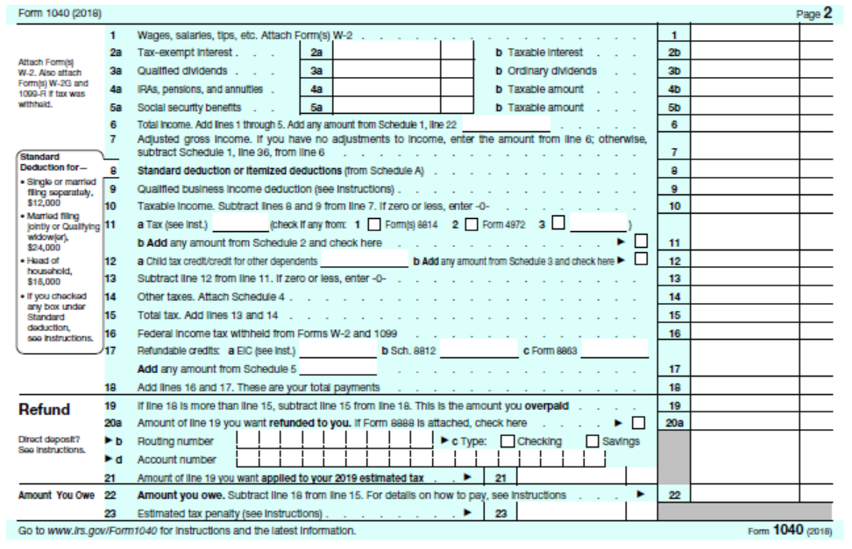
Individual Overview
Page 2 of 1040
Common income items
Summary of all else
Refund/Payable

Slide 4
Tax payments
Remember, we have a pay as you go system
Settle up with filing of tax return
If payments > tax = refund
If payments < tax = additional payment (and maybe penalties and interest)
For wage earners, tax withholding is typical source of tax payments
For other income, estimated tax payments

Slide 5
Tax payments
Estimated tax payments are due 4/15, 6/15, 9/15, and 1/15 of following year
NOT April 15
So what if you do not pay until later?
Penalties and interest, that’s what!
Madge’s tax liability was $1,000, her withholding was $999.
Is she subject to penalties and interest?

Slide 6
Tax payments
Need a reasonable rule – have one in place
For those with AGI of $150,000 or less
Must have paid 90% of this year’s tax or
100% of last year’s tax
AGI over $150,000
90% of this year’s tax or
110% of last year’s tax
Those with AGI over $150,000 are considered more sophisticated and capable of better estimating income and liability

Slide 7
Tax payments
Alicia’s income tax withholding plus estimated payments totaled $30,000 for 2017. When she prepared her tax return in April of 2018, her AGI was $145,000 and her tax liability was $32,000. Her tax liability in 2016 was $30,300. Is Alicia subject to undepayment penalties?
AGI < $150,000
90% of this years tax $28,800
100% last years tax $30,300
Her payments exceed 90% of this years tax so no penalties.

Slide 8
Tax payment
Irrespective of penalties, any tax due must be paid by April 15 (filing deadline) of following year or penalties and interest
April 15 whether or not the taxpayers extends the filing deadline of their return
Recall Alicia owes $2,000 on her 2017 tax return. Although not subject to penalties, Alicia must pay the $2,000 by April 15th to avoid late payment penalties.

Slide 9
Tax payments
End of Video T14G

