Slide 1
ACCTG 325 Video T14B
Overview of Individual Taxation

Slide 2
Individual Overview
4 step process to taxable income (follows Form 1040)
Total income
Adjusted gross income
Standard/Itemized deductions
Qualified Business Income (QBI) deduction
Prof Gill says add two more
Calculate tax
Apply credits and payments

Slide 3
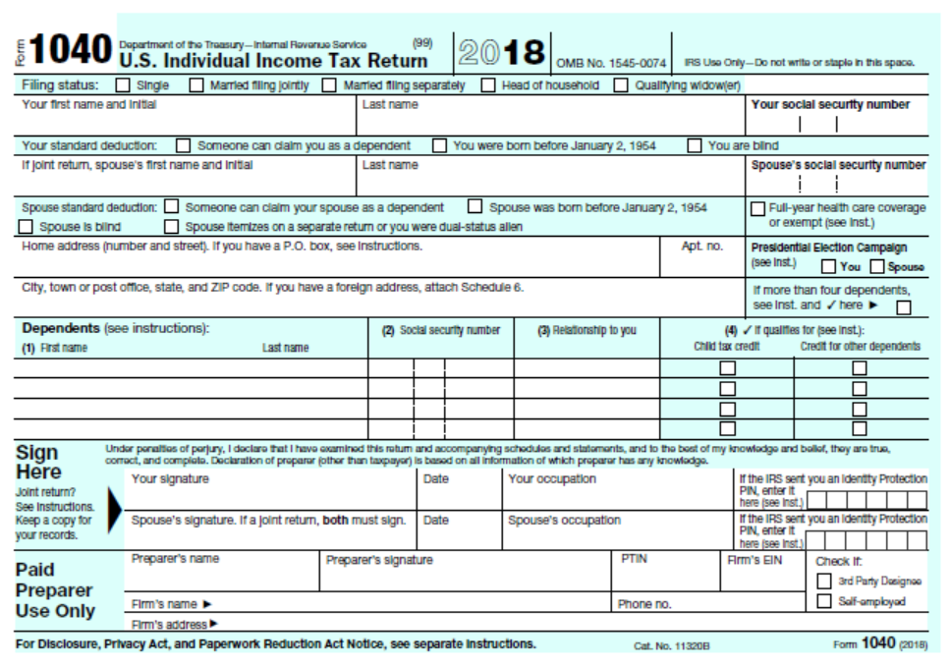
Individual Overview
Page 1 of 1040
Taxpayer info
Filing status
Dependents

Slide 4
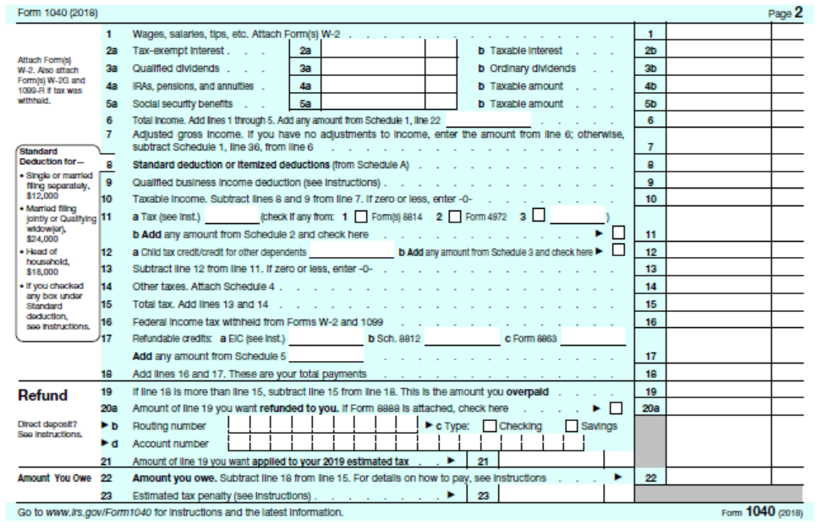
Individual Overview
Page 2 of 1040
Common income items
Summary of all else
Refund/Payable

Slide 5
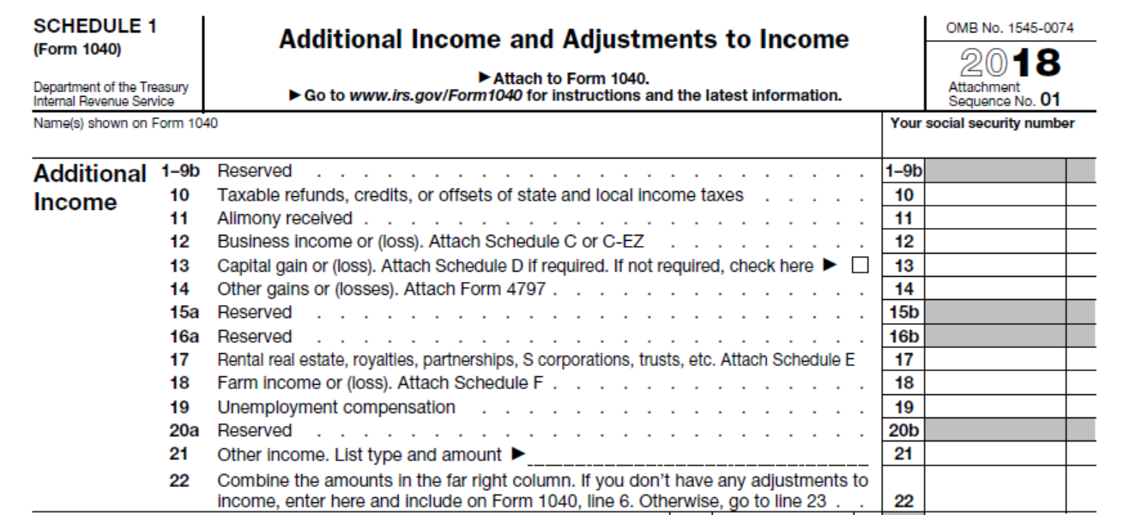
Individual Overview
Schedule 1 Top Section
Other income sources
Pulls from other Schedules

Slide 6
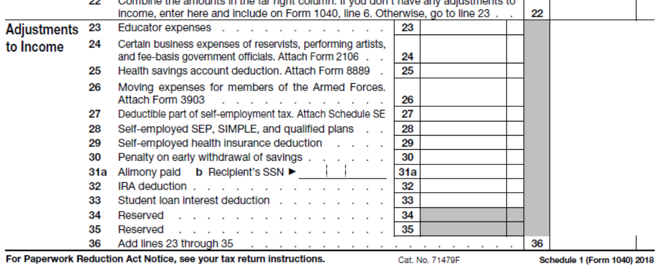
Individual Overview
Schedule 1 Bottom Section
FOR AGI adjustments

Slide 7
Individual Overview
Step 2: Adjusted Gross Income (AGI)
Tax law permits selected “above the line” deductions
Creates a subtotal of distinction
Used as a measuring stick for “fairness” – recall 10% of casualty losses
Need a total so that deductions do not create a circular computation
Example of wrong way
Deduction Y is limited to 10% of taxable income
Total income before deduction Y is $100, deduction Y = $10
Taxable income = $90 thus deduction Y = $9
Taxable income = $91 thus deduction Y = $9.10
Taxable income = $91.90 thus deduction Y = $9.19, etc, etc, etc.

Slide 8
Individual Overview
Some of the adjustments to total income to get to AGI
IRA deductions
Self-employment taxes
Alimony
Student loan interest
Underlying presumption is that these deductions should be less sensitive to the amount of income earned by the taxpayer
Above the line deductions (“FOR AGI” deductions)
Definitely NOT the same as itemized deductions

Slide 9
Individual Overview
Page 2 of 1040
Common income items
Summary of all else
Refund/Payable

Slide 10
Individual Overview
Step 3: Standard deduction or itemized deductions
Quick summary
These are not all deductions
Deductions from business and rental income already reflected in total income
For AGI deductions already reflected in AGI
Deduct larger of standard deduction or itemized deductions

Slide 11
Step 4: QBI deduction
This is a complex deduction that we will deal with in summary form.
The actual rules are quite complex

Slide 12
Individual Overview
Page 2 of 1040
Common income items
Summary of all else
Refund/Payable

Slide 13
Individual Overview
Individual Tax Formula
Total (Gross) income
Adjustments for AGI
= Adjusted Gross Income
- Deductions (standard or itemized)
QBI deduction
= Taxable income

Slide 14
Individual Overview
Step 5: Using applicable filing status, compute tax
For income < $100,000, must use tax tables
For income $100,000+, must use tax rate schedules
What we have been using until now

Slide 15
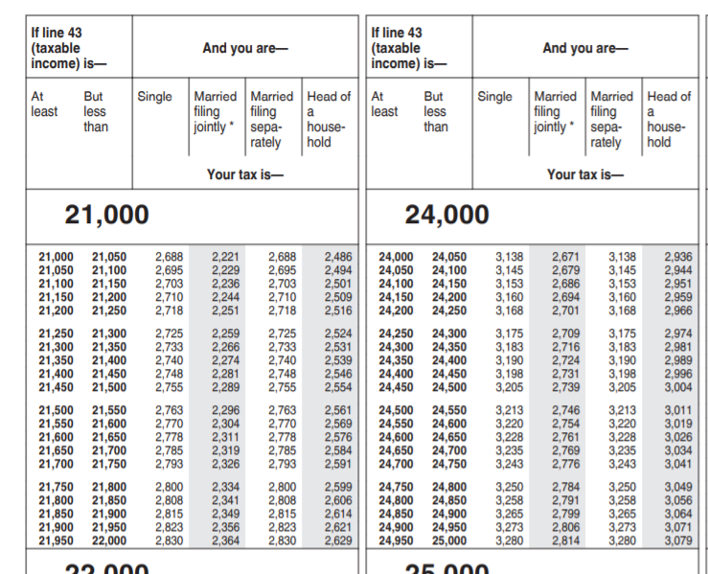
Individual Overview
Tax tables – required when taxable income is below $100,000

Slide 16
Individual Overview
Page 2 of 1040
Common income items
Summary of all else
Refund/Payable

Slide 17
Other Taxes on Line 11
Form 8814: Including your kids taxes on your return
Form 4972: Taxes on lump-sum distribution of pension
Schedule 2

Slide 18
Schedule 2
Pick up the alternative minimum tax (AMT)
Excess advance premiums for health care

Slide 19
Individual Overview
Page 2 of 1040
Common income items
Summary of all else
Refund/Payable

Slide 20
Child tax credit of $2,000 per child
Dependent
Under age 17
Other dependent credit of $500
Dependent

Slide 21
Tax Credits
Credit vs deduction
 | Deduction | Non-refundable Credit | Refundable Credit
Gross Income | 10,000 | 10,000 | 10,000
Deduction | (3,000) | 0 | 0
Taxable Income | 7,000 | 10,000 | 20,000
Tax (20%) | 1,400 | 2,000 | 2,000
Credit |  | (3,000) | (3,000)
Tax after credits | 1,400 | 0 | (1,000)

Slide 22
Individual Overview
Page 2 of 1040
Common income items
Summary of all else
Refund/Payable

Slide 23
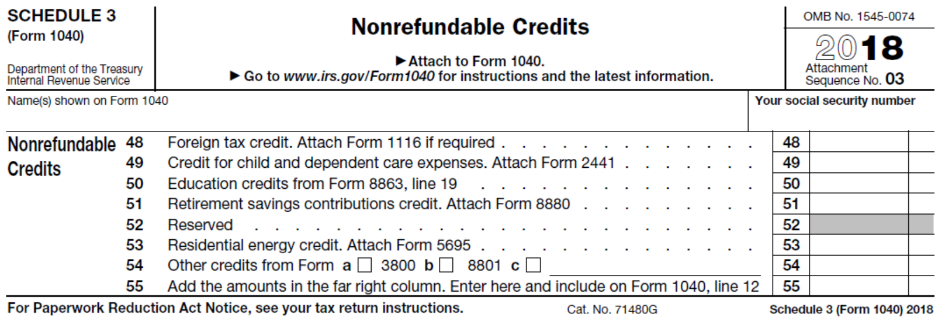
Schedule 3

Slide 24
Individual Overview
Page 2 of 1040
Common income items
Summary of all else
Refund/Payable

Slide 25
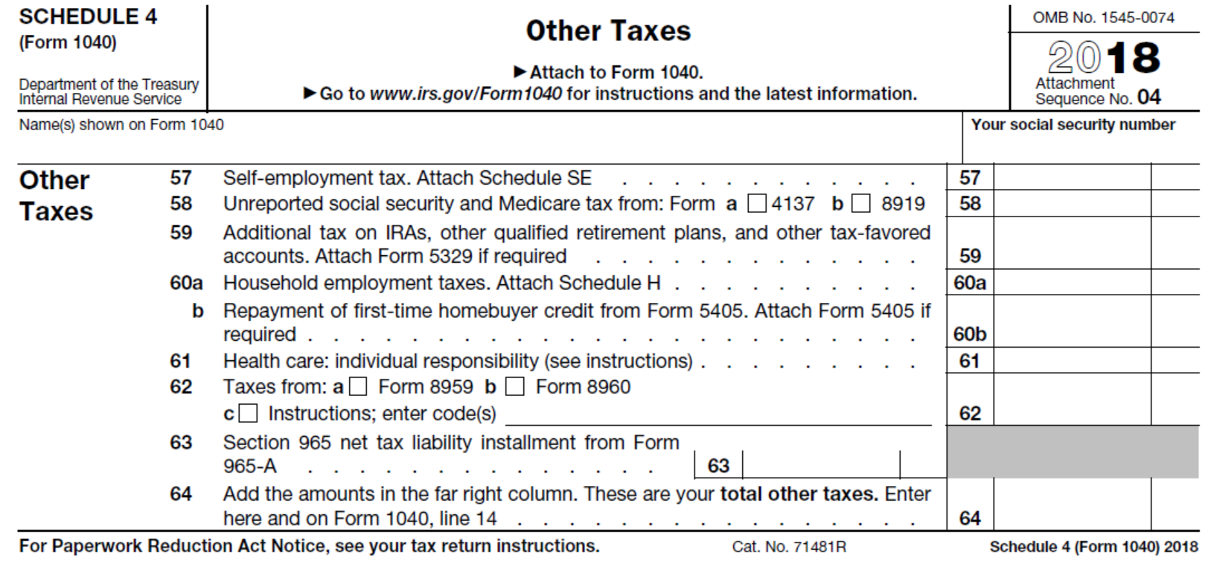

Slide 26
Individual Overview
Page 2 of 1040
Common income items
Summary of all else
Refund/Payable

Slide 27
Taxes withheld (common)
Earned income tax credit
American Opportunities tax credit (Form 8863)
Savers credit (Form 8812)
Schedule 5

Slide 28
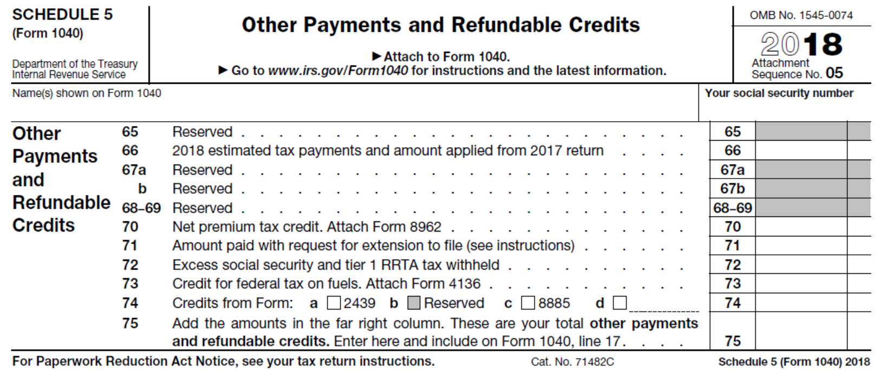

Slide 29
Individual Overview
Page 2 of 1040
Common income items
Summary of all else
Refund/Payable

Slide 30
Individual Overview
Remember, we have a pay as you go system
Settle up with filing of tax return
If payments > tax = refund
If payments < tax = additional payment (and maybe penalties and interest)

Slide 31
Individual Overview
Individual Tax Formula
Total (Gross) income
Adjustments for AGI
= Adjusted Gross Income
- Deductions (standard or itemized)
QBI deduction
= Taxable income
Income tax
+ Other taxes
- Non-refundable tax credits
= Tax after credits
- (Payments + Refundable Credits)
Net tax due/refund

Slide 32
Individual Overview
End of Video T14B

