Slide 1
ACCTG 325 Video T14D
Qualified Business Income Deduction

Slide 2
QBI Deduction
4 step process to taxable income (follows Form 1040)
Total income
Adjusted gross income
Standard/Itemized Deductions
Qualified Business Income (QBI) deduction
Prof Gill says add two more
Calculate tax
Apply credits and payments

Slide 3
QBI Deduction
Step 4: QBI Deduction
Just an overview here (the real coverage is in Module 3)
QBI, Sec 199A, Passthrough deduction
Basically: 20% of your passthough income
Subject to a bevy of limitations

Slide 4
QBI Deduction
Paulette operates a small business as a sole proprietorship (not a separate entity, just her)
This business activity is reported in Schedule C
If Paulette generates income of $10,000
20% of that income is a deduction called the QBI deduction

Slide 5
QBI Deduction
Lowers the rate on Paulette’s business income
Assume 24% tax rate
24% x 80% = 19.2%
 | Wages income | QBI
Income | 20,000 | 20,000
QBI deduction | 0 | (4,000)
Taxable income | 20,000 | 16,000
Tax Rate | 24% | 24%
Taxes | (4,800) | (3,840)
After-tax | 15,200 | 16,160
ETR | 24% | 19.2%

Slide 6
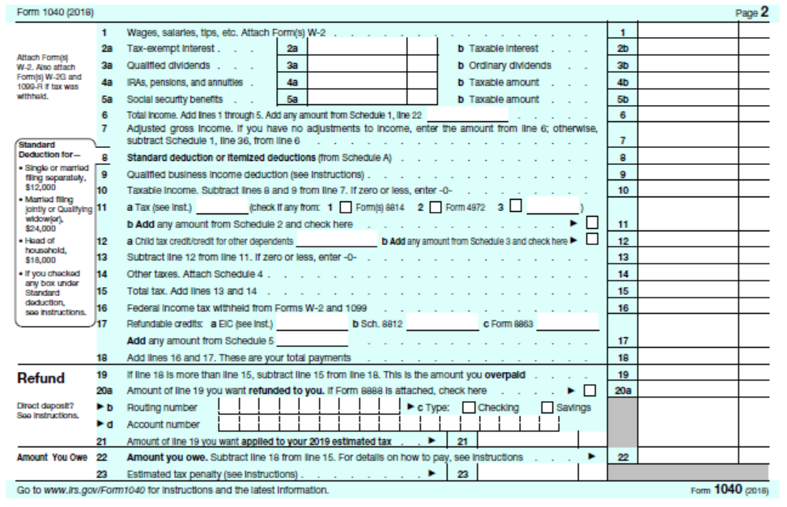
QBI Deduction
Plenty of qualification and limitations

Slide 7
QBI Deduction
End of Video T14D

