Slide 1
ACCTG 325 Video T7D
Special Depreciation Rules

Slide 2
Special Depreciation
Basic MACRS depreciation is the baseline
Tax law has stimulus related provisions
These provisions come and go, change in amounts, increase and decrease but are generally tax-payer friendly
Section 179 immediate expensing
Bonus depreciation
Listed property and auto limits

Slide 3
Special Depreciation
Daniel lives in Toshland and just purchased a $100 business asset. Toshland has very unusual tax rules in that when assets are purchased, taxpayers can either deduct the cost or capitalize the cost and then write it off evenly over three years. Daniel has more than enough income to offset any deductions regardless of the choice of method. Based purely on present value, which method should Daniel choose? You can assume a 30% tax rate and a 5% discount rate if necessary.
Deduct Immediately
Year | 1
Outflow | ($100)
Deduction | ($100)
Tax Rate | 30%
Tax Savings | 30
Capitalize and deduct ratably
Year | 1 | 2 | 3 | Total
Outflow | ($100) | 0 | 0 | ($100)
Deduction | ($33) | ($33) | ($34) | ($100)
Tax Rate | 30% | 30% | 30%
Tax savings | 10 | 10 | 10 | 30
PV | 10 | 9.52 | 9.07 | $28.59

Slide 4
Special Depreciation
Thus deducting immediately lowers the cost of purchasing equipment
If the after-tax cost is cheaper, maybe more business property will be purchased
Oops – I let economics slip back in

Slide 5
Special Depreciation
Section 179 – immediate expensing
Can deduct the cost of qualifying property up to $510,000 (2017)
New tax law now $1 million
Hobie Corp purchases $750,000 of new furniture for the office in 2018. Typically 7 year property.
Will deduct $750,000 immediately
No future depreciation and adjust basis

Slide 6
Special Depreciation
Section 179 intended for small businesses
How define small business?
Business places into service less than “threshold amount” of qualifying property during the year
2017 threshold is $2,030,000. 2018 threshold is $2,500,000
Phases out $1 for $1 for amounts in excess of threshold
Hobie Corp places in service $2,650,000 of qualifying property in 2018
$2,650,000 - $2,500,000 = $150,000 phase out
$1,000,000 - $150,000 = $850,000 eligible Section 179 deduction

Slide 7
Special Depreciation
Section 179 is considered a special benefit
So benefit is limited to amount of taxable income before considering Section 179
Hobie Corp places in service $2,650,000 qualifying property and has taxable income after all deductions except 179 of $470,000
Hobie is eligible for $850,000 (see previous example) but may only deduct $470,000. Excess Section 179 of $380,000 can be carried forward

Slide 8
Special Depreciation
Section 179 is elective
Can take on one asset, part of one asset, two assets, or none at all
Amount is determined annually (and is adjusted for inflation each year)
Qualifying property
Tangible personal property
Off-the-shelf computer software (considered an intangible normally)
Can be new or used
Now includes certain non-residential real property: improvements (not expansions), roofs, HVAC, fire protection, security

Slide 9
Special Depreciation
Section 179 used to be a big deal….until bonus depreciation
Not elective (may elect out)
Permits “uber-accelerated” depreciation
Old tables
New Tables
Year | 2017 | 2018 | 2019 | 2020
Amount | 50% | 40% | 30% | 0%
Year | Up to 9/27/2017 | 9/28/2017-12/31/2022 | 2023 | 2024 | 2025 | 2026
Amount | 50% | 100% | 80% | 60% | 40% | 20%

Slide 10
Special Depreciation
May depreciate 100% in first year
Qualifying property
Recovery period of 20 years or less (basically no buildings)
Computer software
Used property OK as long as purchased
Hobie Corp places in service $2,650,000 of new furniture in 2018
Under 100% bonus deducts all $2,650,000. Adjusted basis = $0

Slide 11
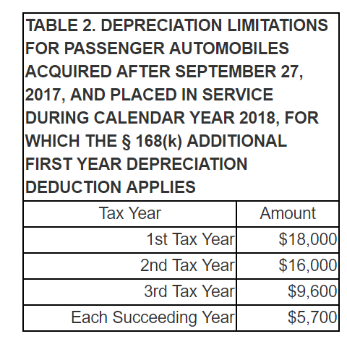
Special Depreciation
Listed property and limits
Certain property is subject to taxpayer abuse and is placed on a list by the IRS
Listed property
One form of listed property is auto used in business
Depreciation limited to annual amount per vehicle
2018 limits
$70,000 placed in service in 2018
Year 1: $70,000 x 100% (bonus) but limited to $18,000

Slide 12
Special Depreciation
Cost | $70,000
Year 1 | $18,000
Year 2 | $16,000
Year 3 | $9,600
Year 4 | $5,700
Years 5-7 | $5,700
Year 8 | $3,600

Slide 13
Special Depreciation
Business use percentage
Yoda purchases new auto for $60,000. He uses his auto 80% for business
$60,000 x 80% x 100% = $48,000
Limited to $18,000….
Limited to $18,000 x 80% = $14,400
Business use % applies to any business property

Slide 14
Special Depreciation
End of Video T7D

