Slide 1
ACCTG 325 Video T4F
Character

Slide 2
Character
The tax code permits different types of income to have different tax rates
Back in entity, we discussed dividends having a 15% rate; thus dividend income (15%) can be preferred to interest income (ordinary income tax rates between 10 and 39.6% [now 37%])
The character and preferential rates are a function of tax law
As a result, knowledge of tax law is tantamount to taking advantage of character

Slide 3
Character
Typical characters
Ordinary – use the income tax rate that applies to that income
Capital Gain/Dividends
If long term can be taxed at 0% but more typically 15%
20% for highest income earners
Also has special 25% and 28% types (more much later)
Short term is taxes at ordinary rates
Tax exempt
Tax rate = 0%

Slide 4
Character
2017
Income level | Long-term capital gains rate
Married filing jointly
$0-$75,900 | 0%
$75,901-$470,700 | 15%
> $470,701 | 20%
Single
$0-$37,950 | 0%
$37,951-$418,400 | 15%
> $418,401 | 20%
Head of household
$0-$50,800 | 0%
$50,801-$444,550 | 15%
> $444,551 | 20%
2018
Income level | Long-term capital gains rate
Married filing jointly
$0-$77,200 | 0%
$77,201-$479,000 | 15%
> $479,001 | 20%
Single
$0-$38,600 | 0%
$38,601-$425,800 | 15%
> $425,801 | 20%
Head of household
$0-$51,700 | 0%
$51,701-$452,400 | 15%
> $452,401 | 20%

Slide 5
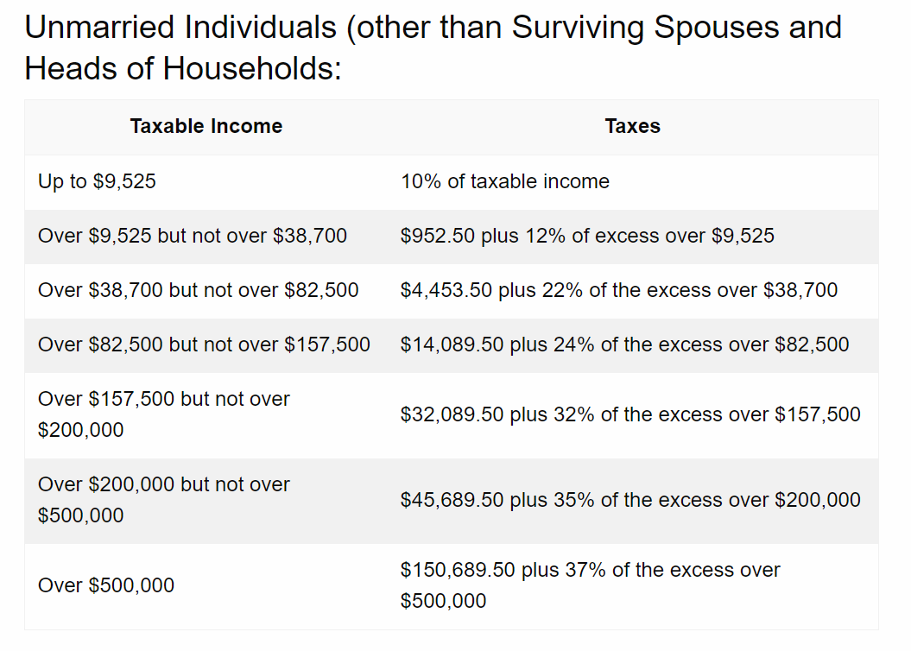
Character
2018
Income level | Long-term capital gains rate
Married filing jointly
$0-$77,200 | 0%
$77,201-$479,000 | 15%
> $479,001 | 20%
Single
$0-$38,600 | 0%
$38,601-$425,800 | 15%
> $425,801 | 20%
Head of household
$0-$51,700 | 0%
$51,701-$452,400 | 15%
> $452,401 | 20%

Slide 6
Character
Luke, Yoda and Obiwan all generate $100 of taxable income – all three are in the 35% tax bracket
Much planning has been around converting ordinary to cap gain
Tax exempt is very restricted
 | Luke | Yoda | Obiwan
Character | Ordinary | LT Capital | Tax exempt
Pretax amount | $100 | $100 | $100
Tax | 35 | 15 | 0
After-tax | 65 | 85 | 100

Slide 7
Character
Carried interest
Hedge fund managers earn income in two ways
2% - take a 2% fee on every dollar invested
Carried interest – take a share of the return above a fixed amount
If returns exceed 20%, the manager keep 50% of all returns above that amount
Is carried interest a fee for services (almost certainly ordinary) or is it return on investment (almost certainly capital)?
Rules are clear - capital

Slide 8
Character
To implement the character strategy, you must:
Understand the differences in tax treatment across various types of income, expenses, and activities and
Have some ability to alter the nature of the income or expense to receive the more advantageous tax treatment

Slide 9
Character
Bill is contemplating three different investments, each with the same amount of risk: (A) a high-dividend stock that pays 8% dividends annually with no appreciation potential, (B) taxable corporate bonds that pay 9% interest annually, (C) tax-exempt municipal bonds that pay 6% interest annually. Assume that dividends are taxed at 15% and that Bill’s marginal tax rate on ordinary income is 30%, which investment should Bill choose?

Slide 10
Character
Therefore, the high-dividend stock would give the highest return for the investment
 | Stock | Bond | Muni Bond
Pretax | 8% | 9% | 6%
(PT x (1-TR)) | 8% * (1 - 15%) | 9% * (1 - 30%) | 6% * (1- 0%)
After-tax | 6.8 | 6.3 | 6.0

Slide 11
Character
Implicit tax can be a serious problem for character planning
If the market can equalize, it will

Slide 12
Character
End of Video T4F

